Slide 1
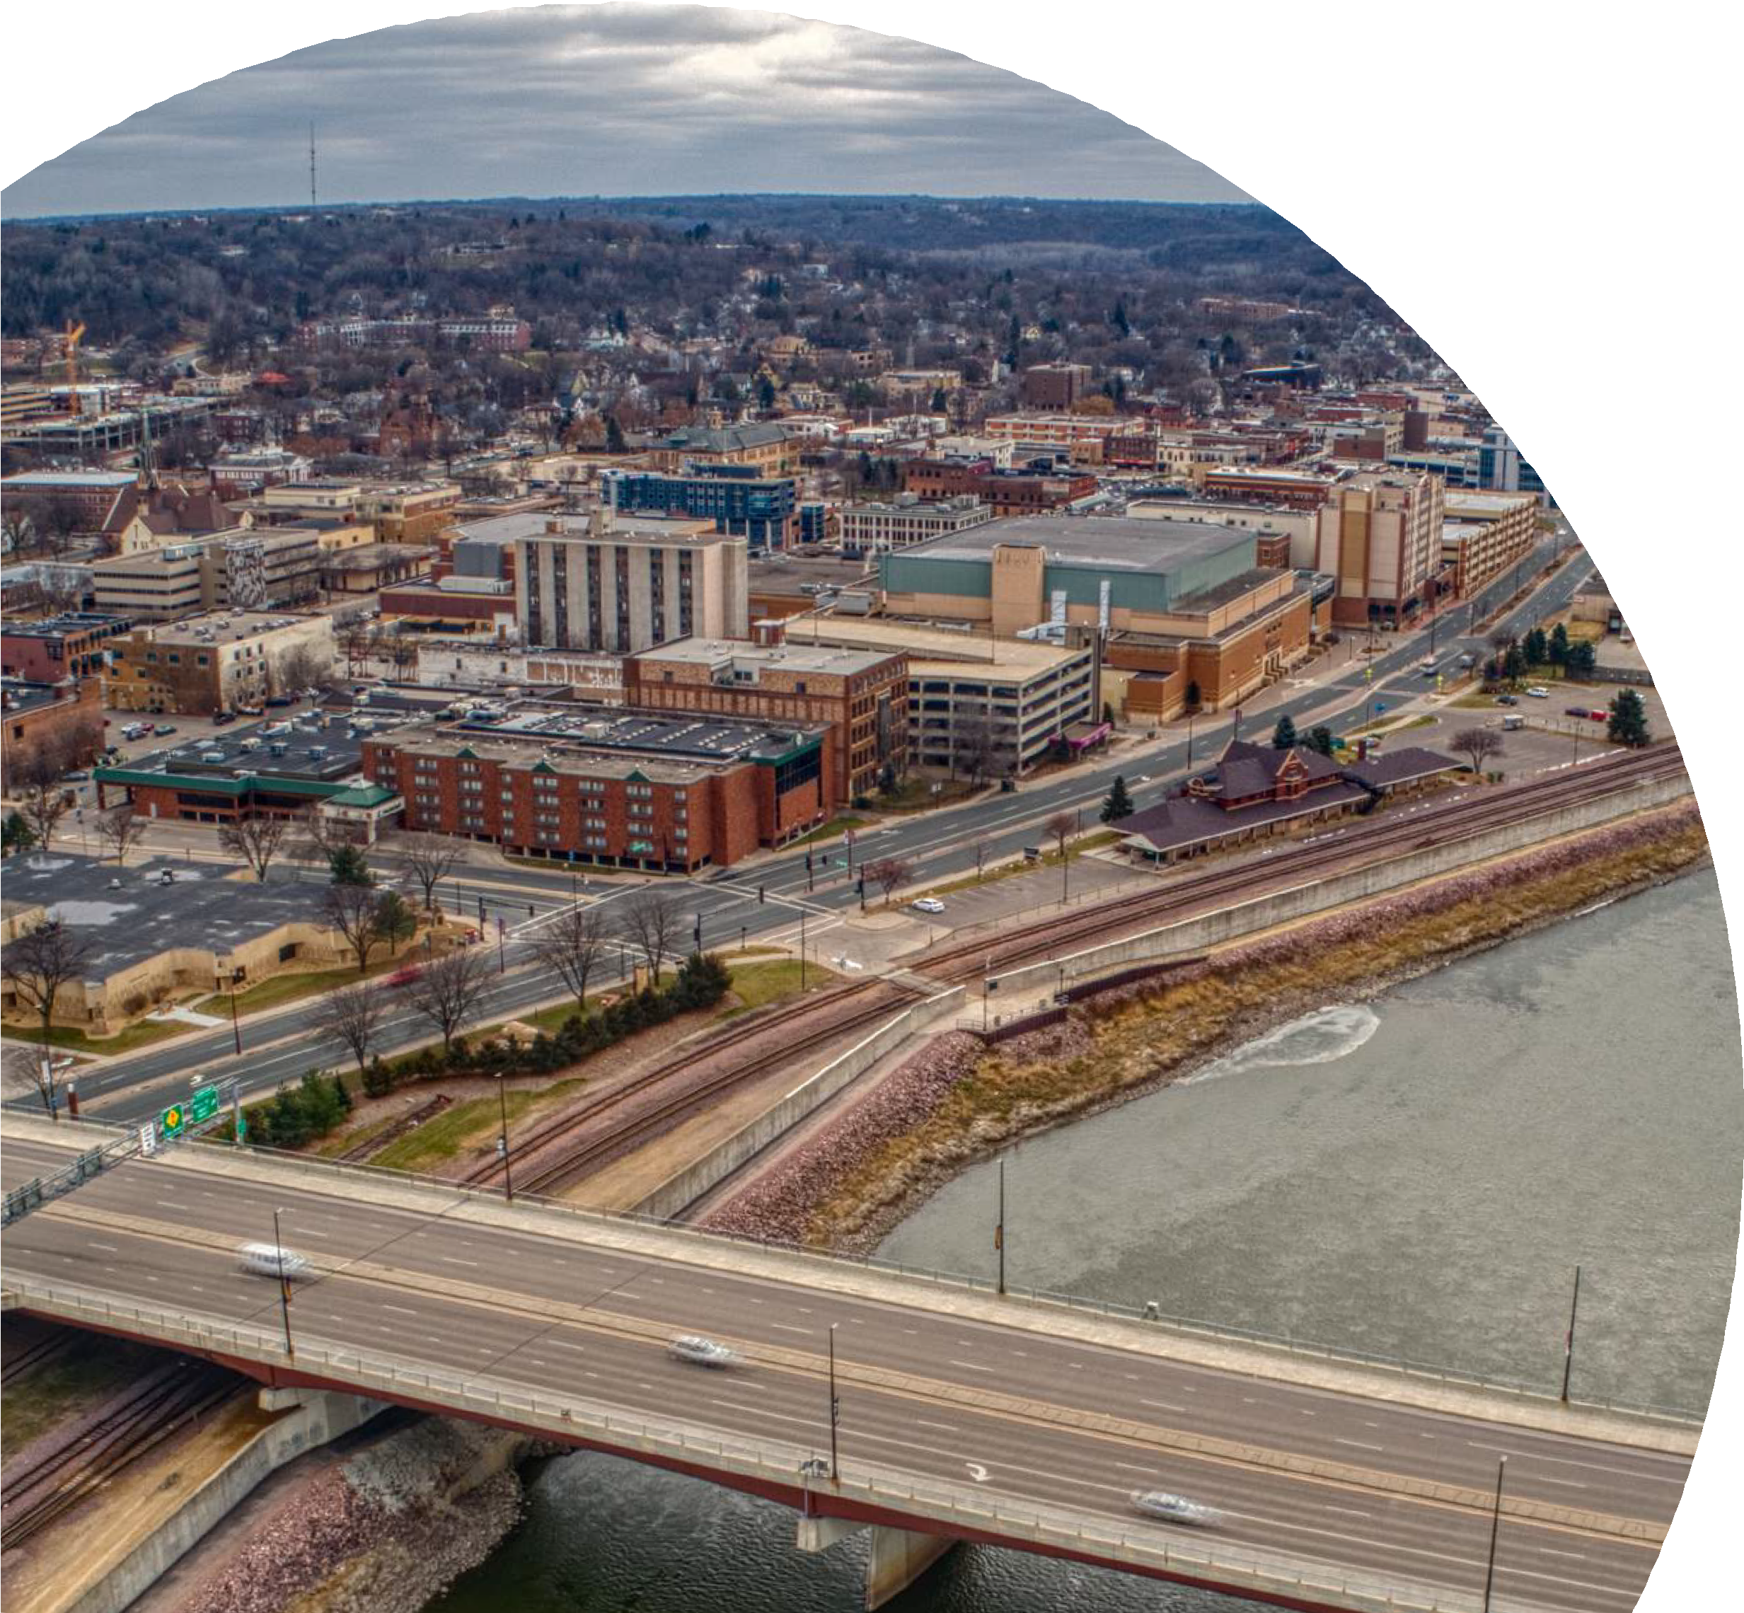
Presentation to the Minnesota Association of Development Organizations (MADO)
LMC
All Staff Conference
Wednesday, November 2, 2022
David Unmacht
Executive Director League of Minnesota Cities

Slide 2
Classic Roles of a Policy Board
1 CREATE AND IDENTIFY EXPECTATIONS FOR STAFF
2
MAKE A COMMITMENT TO THE ROLE AND MISSION
3
DEVELOP A CONSISTENCY IN POLICY AND ACTIONS
4
FOCUS ON POLICY, STRATEGY, AND VISION
5
KEEP STAFF ACCOUNTABLE FOR GOALS AND WORK
6 KEEP STAFF INFORMED AND EDUCATED ON YOUR OPINIONS
7
CREATE A RESPECTFUL DECORUM AND OPERATING CULTURE
BE CONNECTED TO THE CONSTITUENCY, CITIZENS AND COMMUNITY
8
9
UNDERSTAND THE WORKPLACE; SUPPORT POSITIVE CHANGE

Slide 3
Forty Years of Working With Boards
Live by no surprise rule
Remain fair and impartial
Listen with intention
Be open to change
Be willing to deliver bad news
Create a personal connection

Slide 4
Considerations for Effective Engagement
1
BE CLEAR IN HOW YOU WANT TO USE THE BOARD
2
KNOW THE MOTIVES FOR WHY BOARD MEMBERS SERVE
3
KNOW THE CULTURE OF YOUR BOARD (POLICY/OPERATIONAL)
4 UNDERSTAND THE POWER OF COLLECTIVE INFLUENCE
5
BE WILLING TO INVEST IN CHANGE PROCESSES
6
BE AN EFFECTIVE FACILITATOR OR LIAISON
7
CHALLENGE YOUR BOARD TO LEAD; LET THEM WIN

Slide 5
Board
Engagement Matrix
HANDOUT

Slide 6
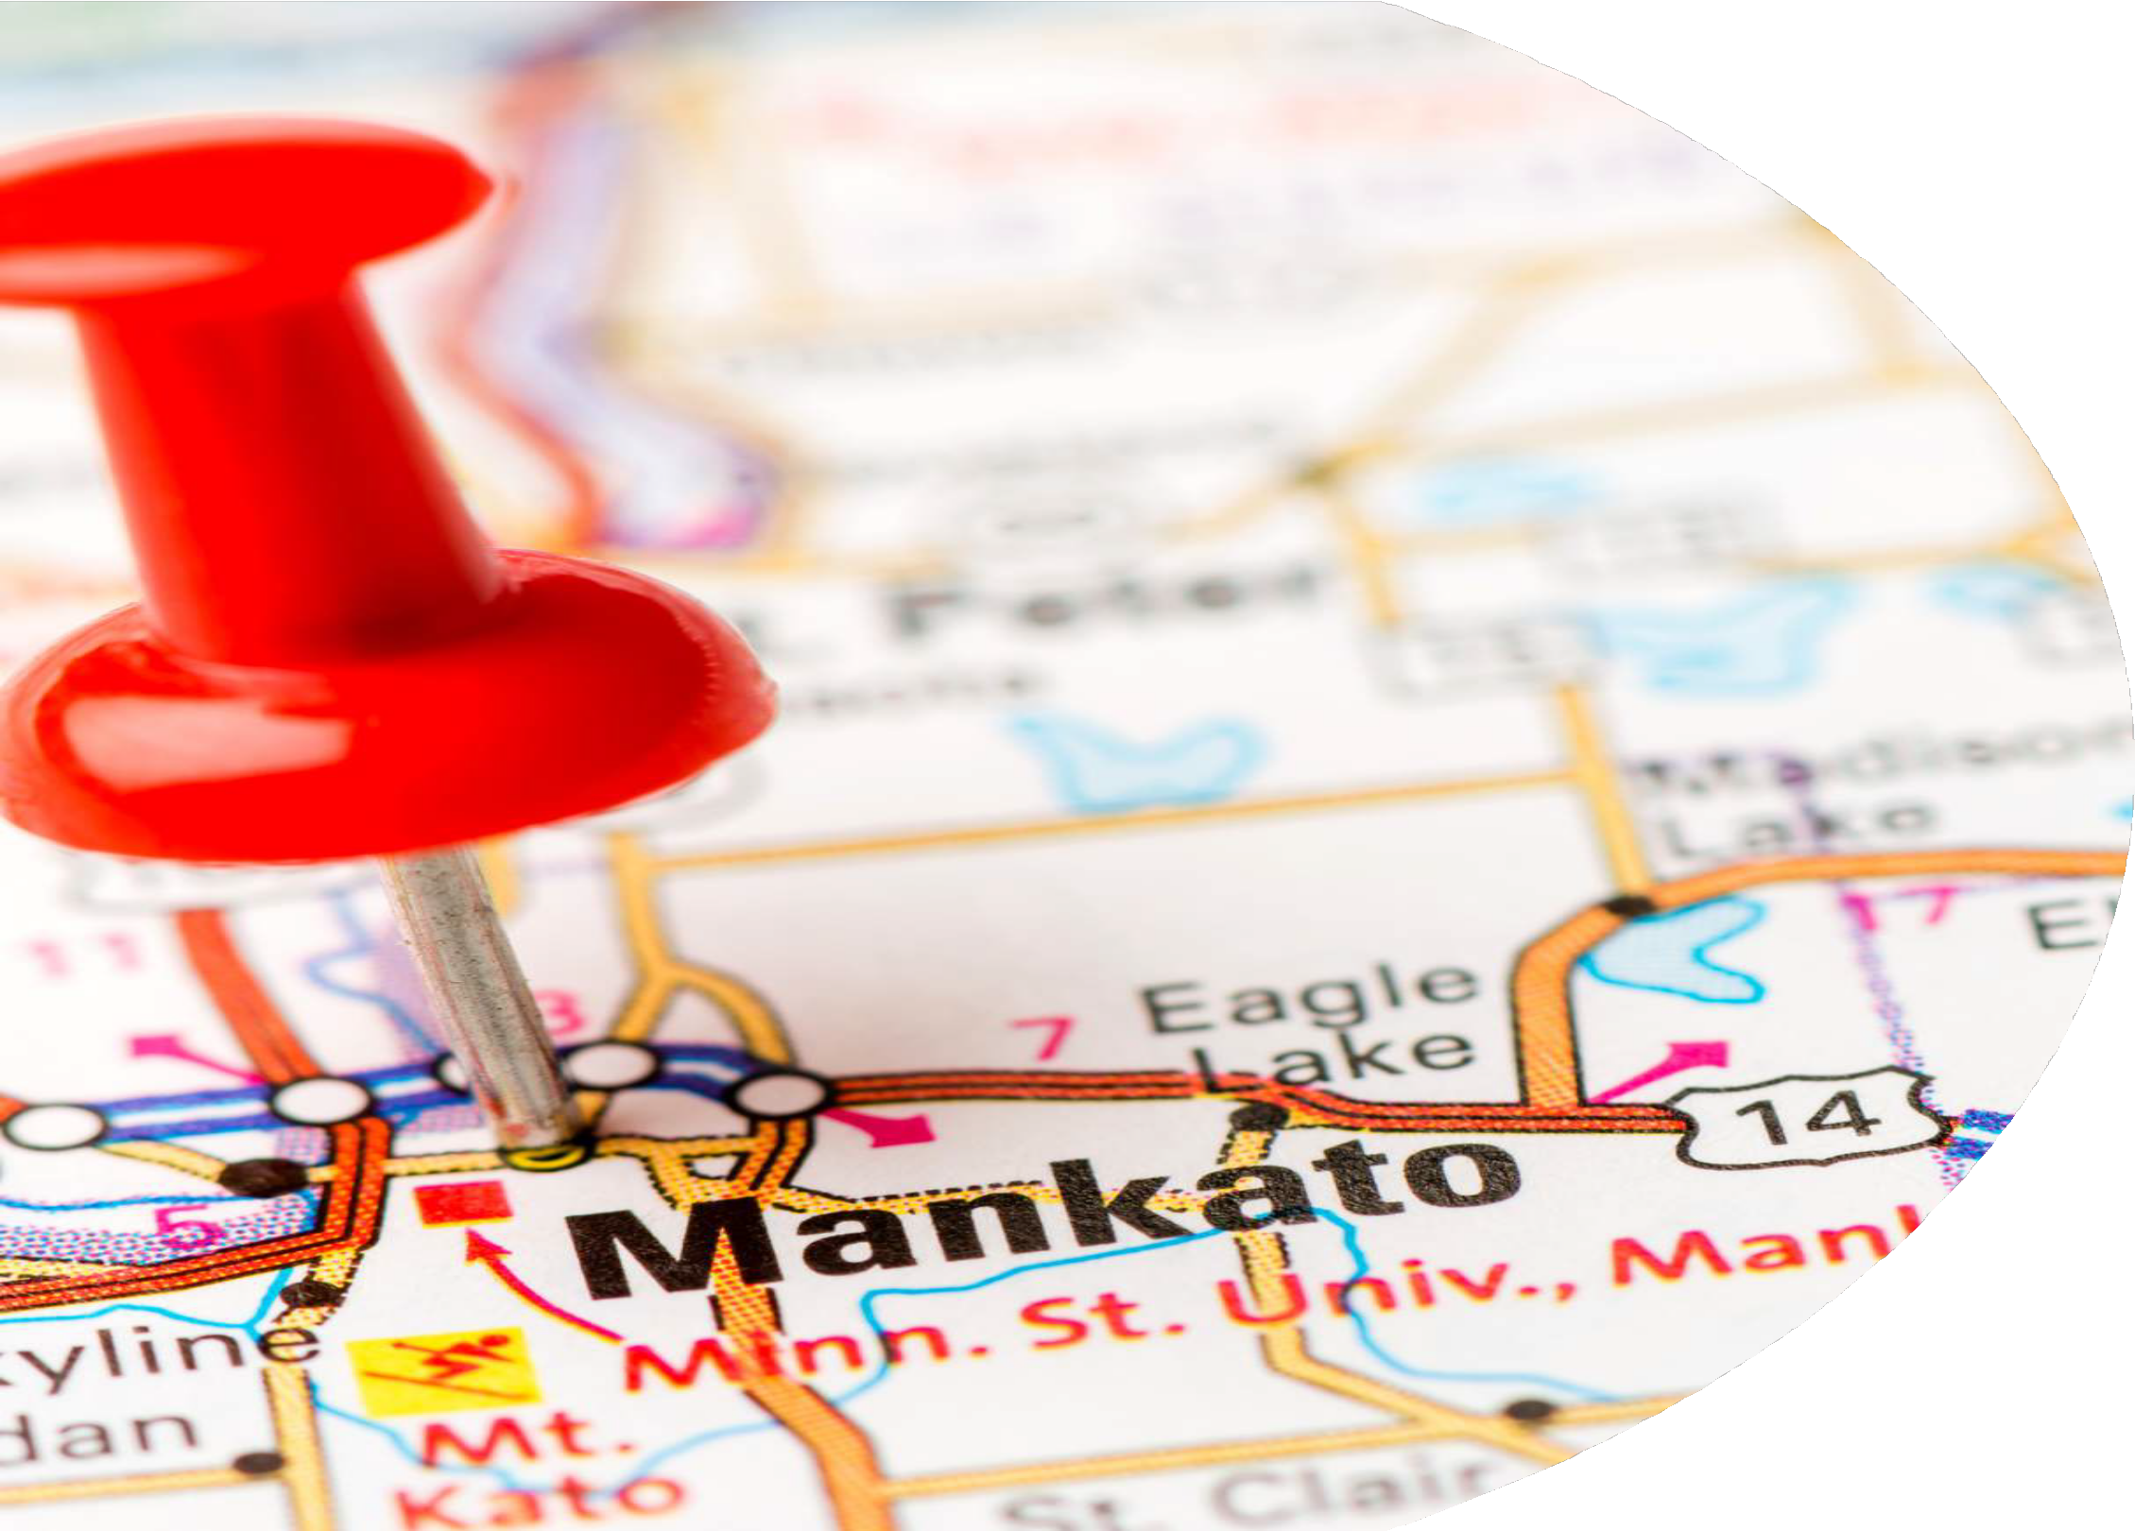
Premier Public Sector Agencies
Plan for the future
Balance short and long-term resources and priorities
Understand roles and expectations
Clear duties and responsibilities Strive for efficiency and effectiveness Implement defined structure and
operating models
Place an emphasis on communication
Both internal and external
Share common values
Respect individual opinions, work to seek consensus
Exercise with the Board

Slide 7
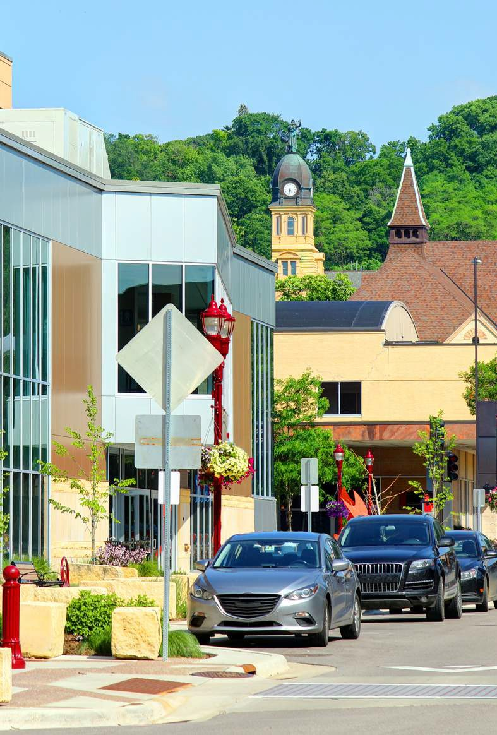
Discussion Questions
What time commitment do you make to personally engage with your board member(s)? Does it consume a lot of your time; some of your time or very little of your time and why?
How do you engage your board to identify new strategies/approaches/ ideas to address critical issues in your region?
How do you move your board off of a stalemate when progress is stalled, or they cannot reach a decision?

Slide 8
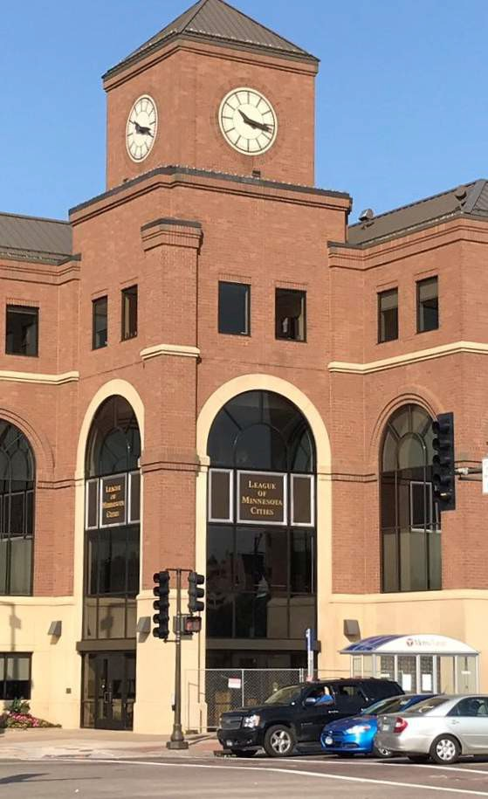
Contact
the League of Minnesota Cities...
LMC
Thank You!
145 University Ave. St. Paul, MN
+651-281-1200
www.lmc.org

