Slide 1
Economic Development
Low Cost, Big Impact

Slide 2
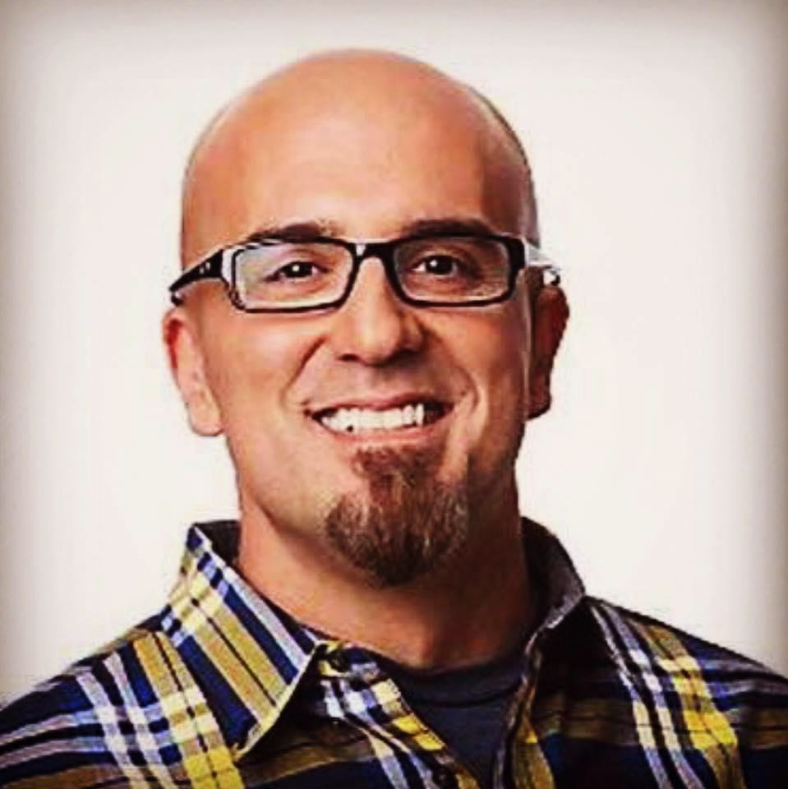
If you steal my material…
you’ve stolen twice.
- Tone E. Fly, KDWB

Slide 3
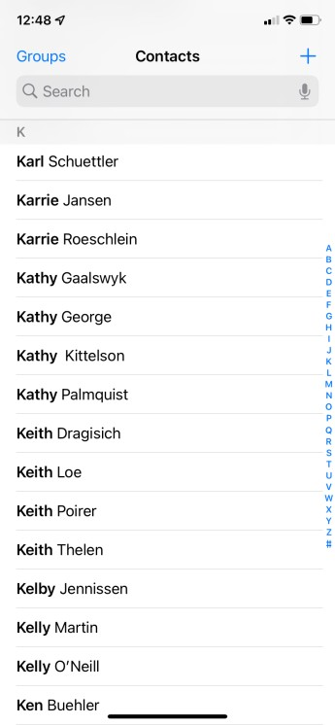
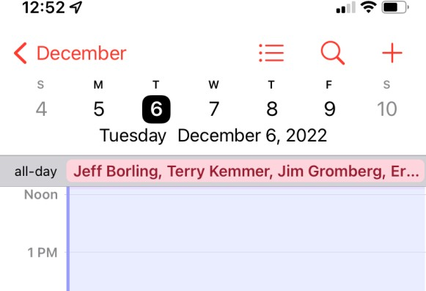
1. Have good contacts
Have a smart phone? If so, use it.
Keep your contacts in there.
Work them!!!
Use as a budget CRM.
Use your calendar for birthdays, anniversaries, etc. (see LinkedIn, Facebook, etc.)

Slide 4
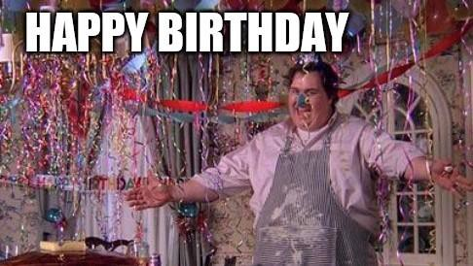
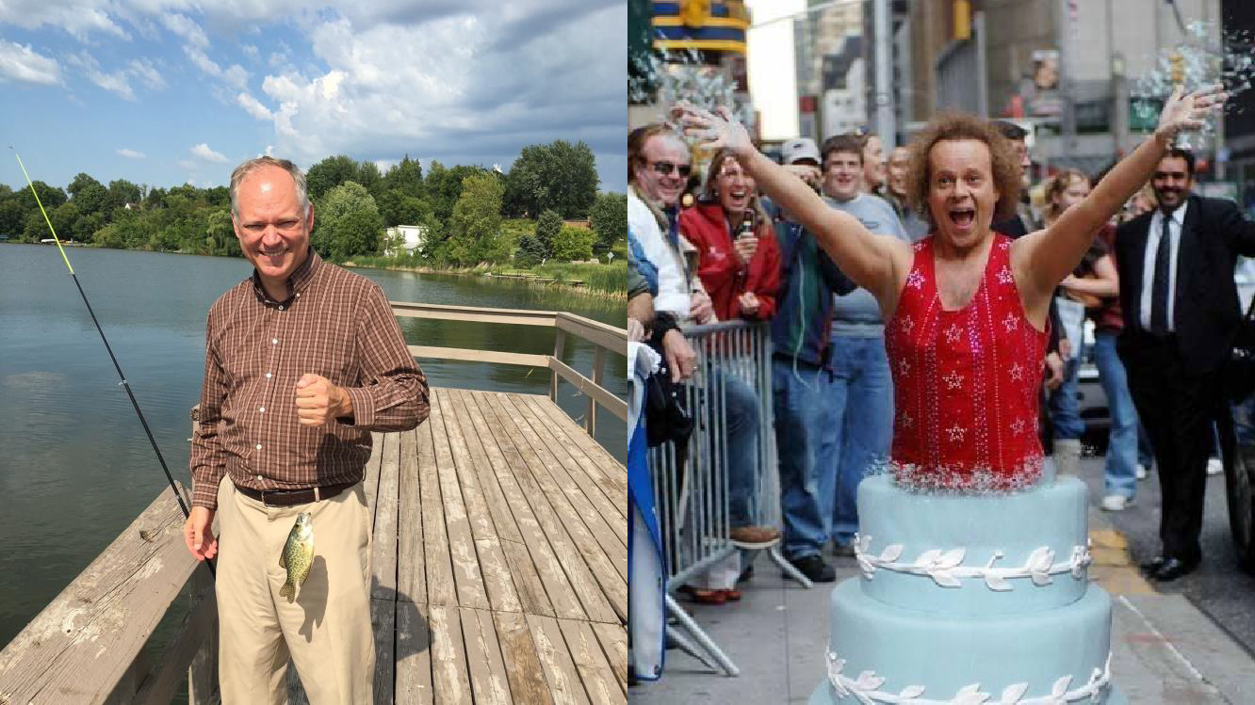
2. Network like your life depends on it.

Slide 5
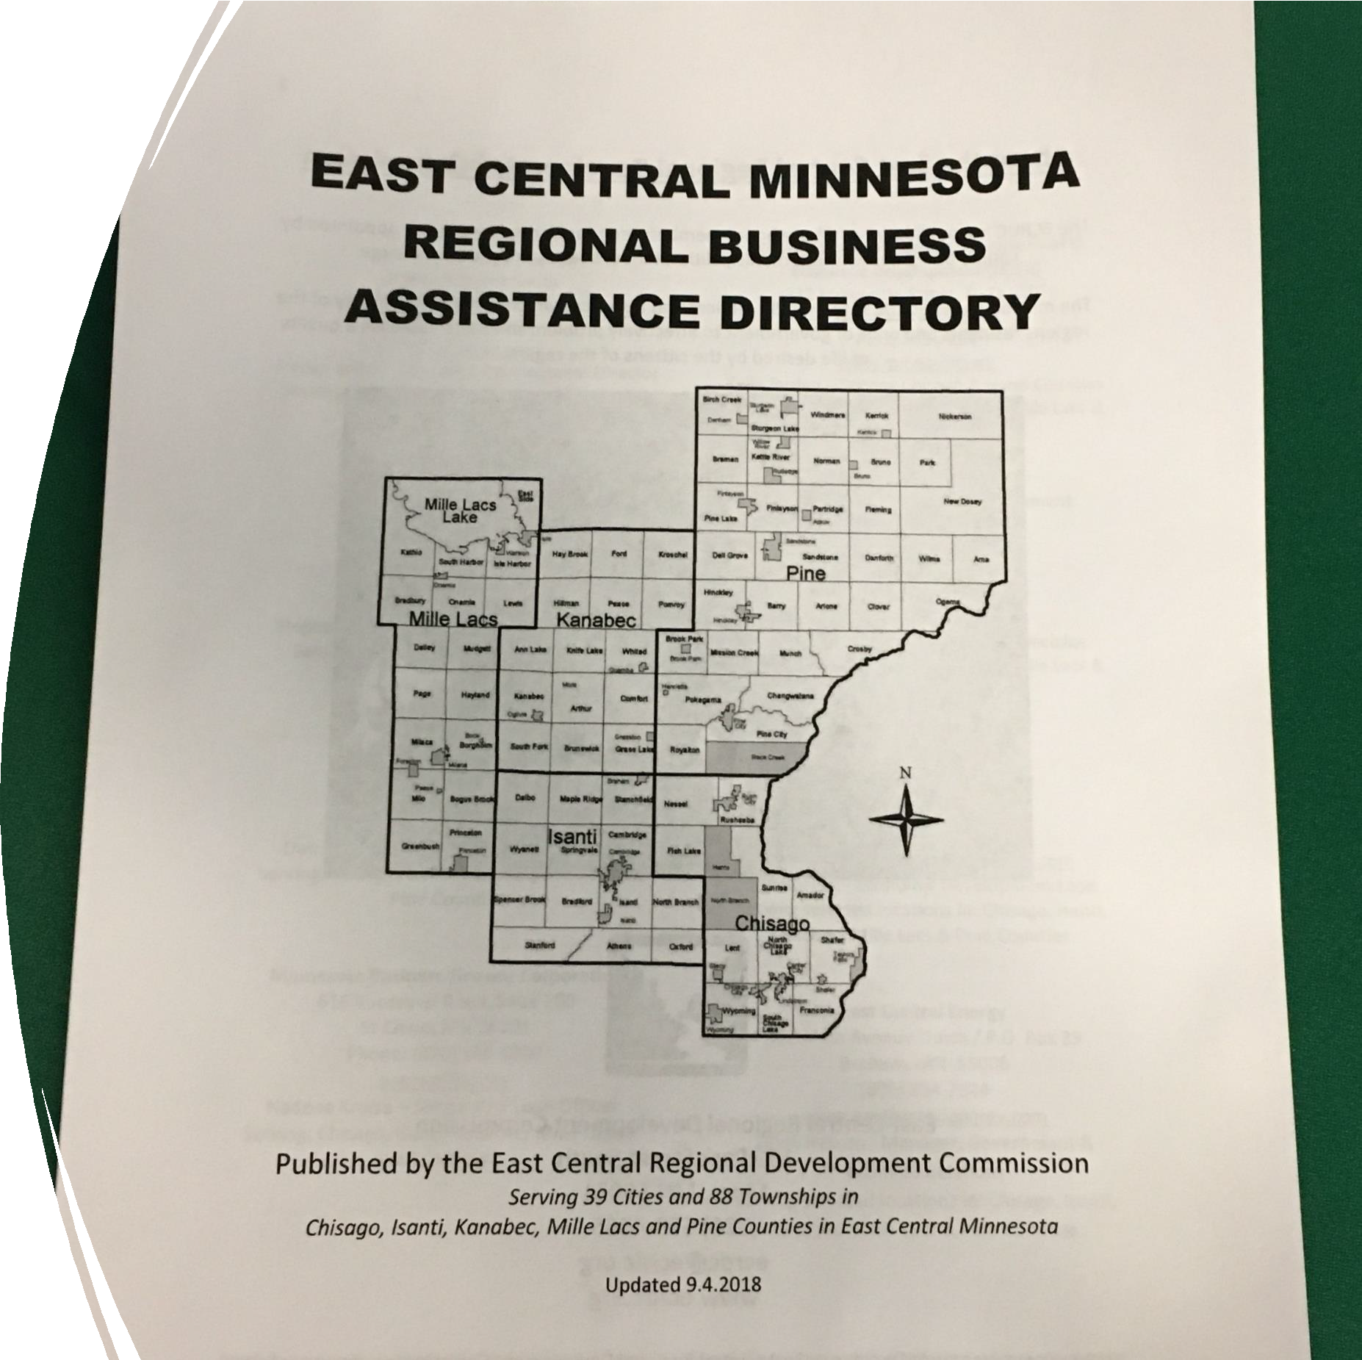
3. Business Assistance Directory
Resources available locally / regionally / statewide.
Post on website, social media, etc.
Email out to your contacts.
Hand it out like water to entrepreneurs, bankers, economic developers, etc.
Locals can “cut it down” for their
purposes.

Slide 6
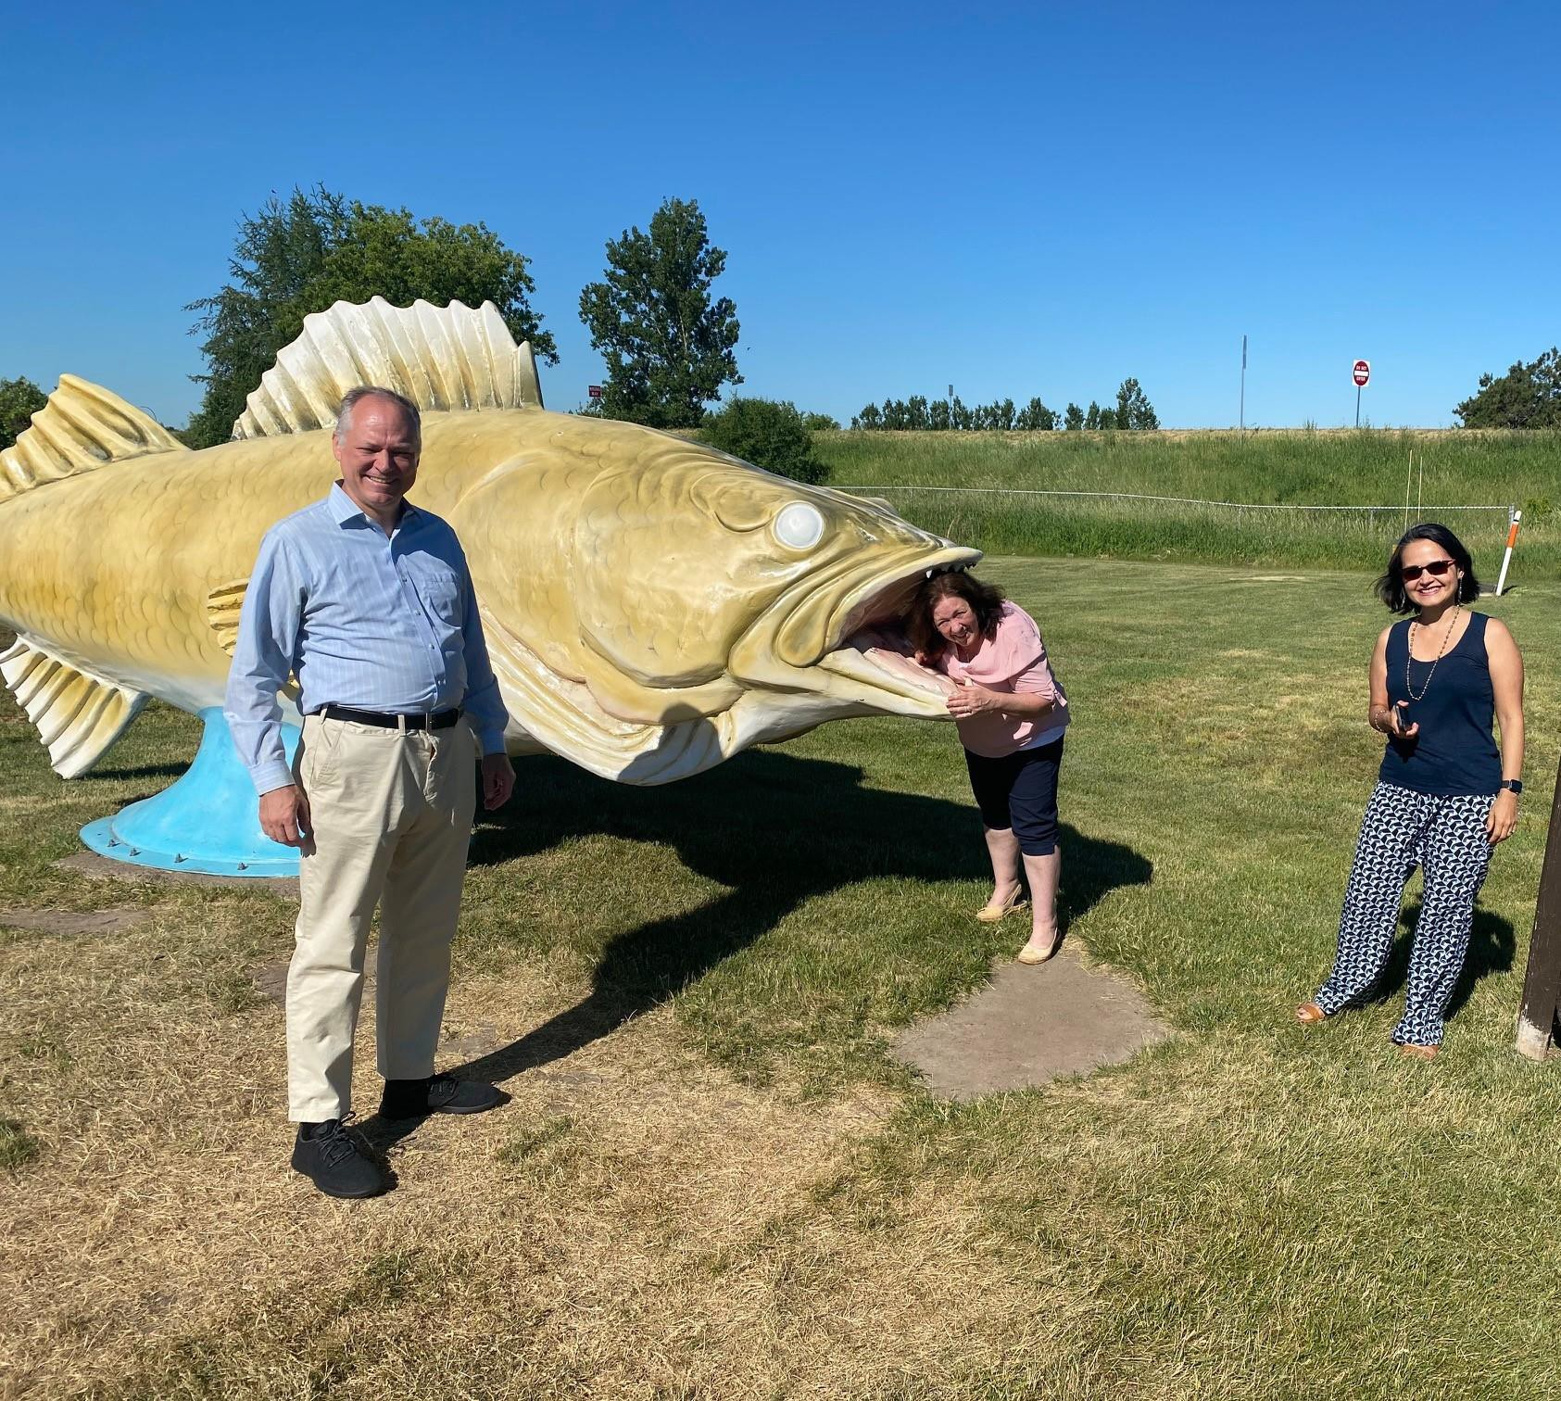
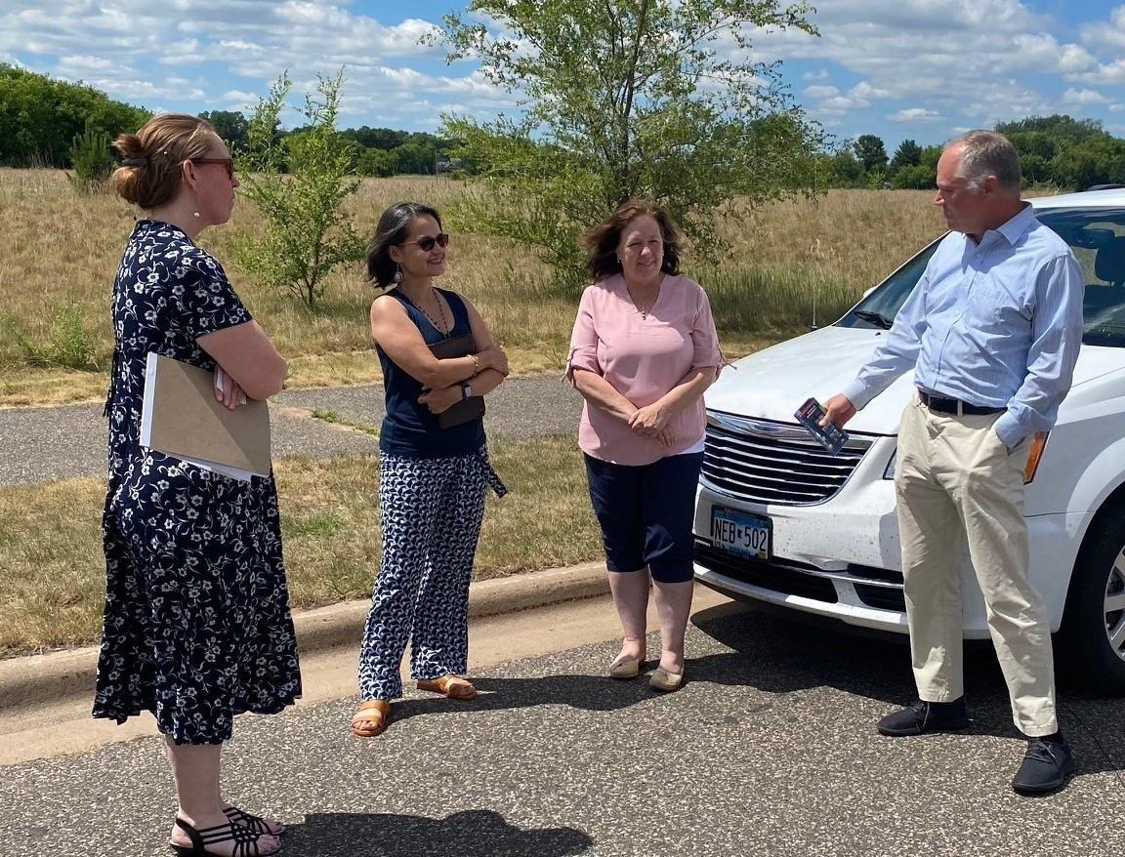
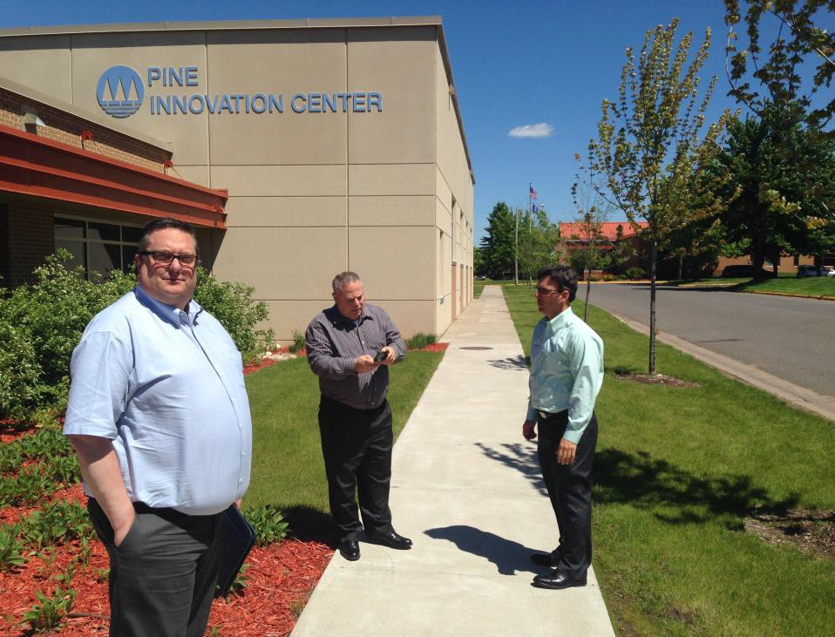
Familiarize influencers and decision makers with your area.
See things, meet connections
and have fun!
Coffee / rolls. Think Casey’s or
Kwik Trip.
4. Fam Tours

Slide 7
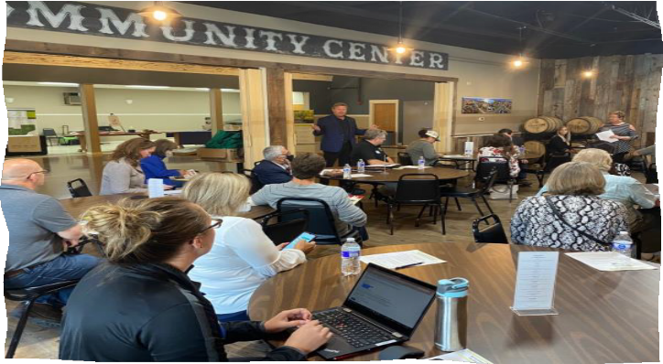
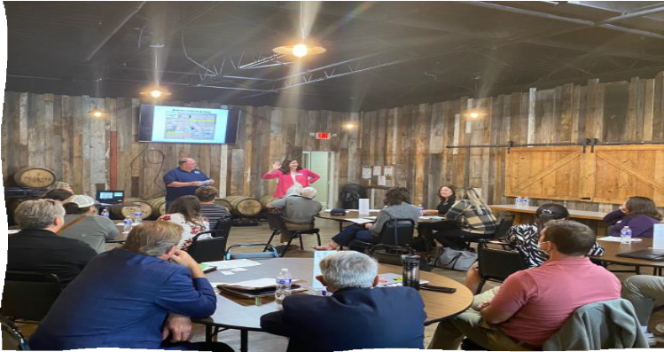
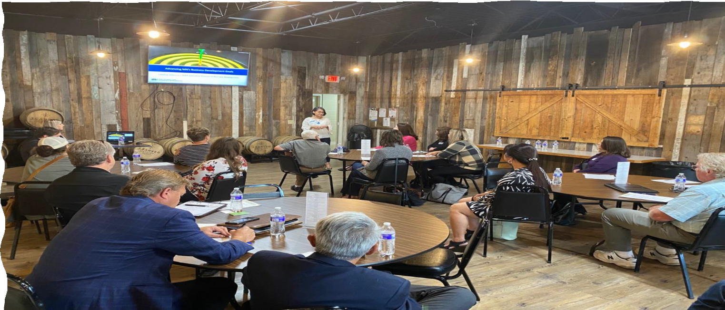
5. Fam Events
Invite influencers (site selectors, RE agents, lenders, economic development big-wigs, etc..
Free beer and apps never hurt.
Continuing education credits help, too.
Talk about your area, available properties, demos / stats, etc.
Hand out business cards and assistance directories like
they’re water.
Collect business cards and do follow up.
Parodic emails.

Slide 8
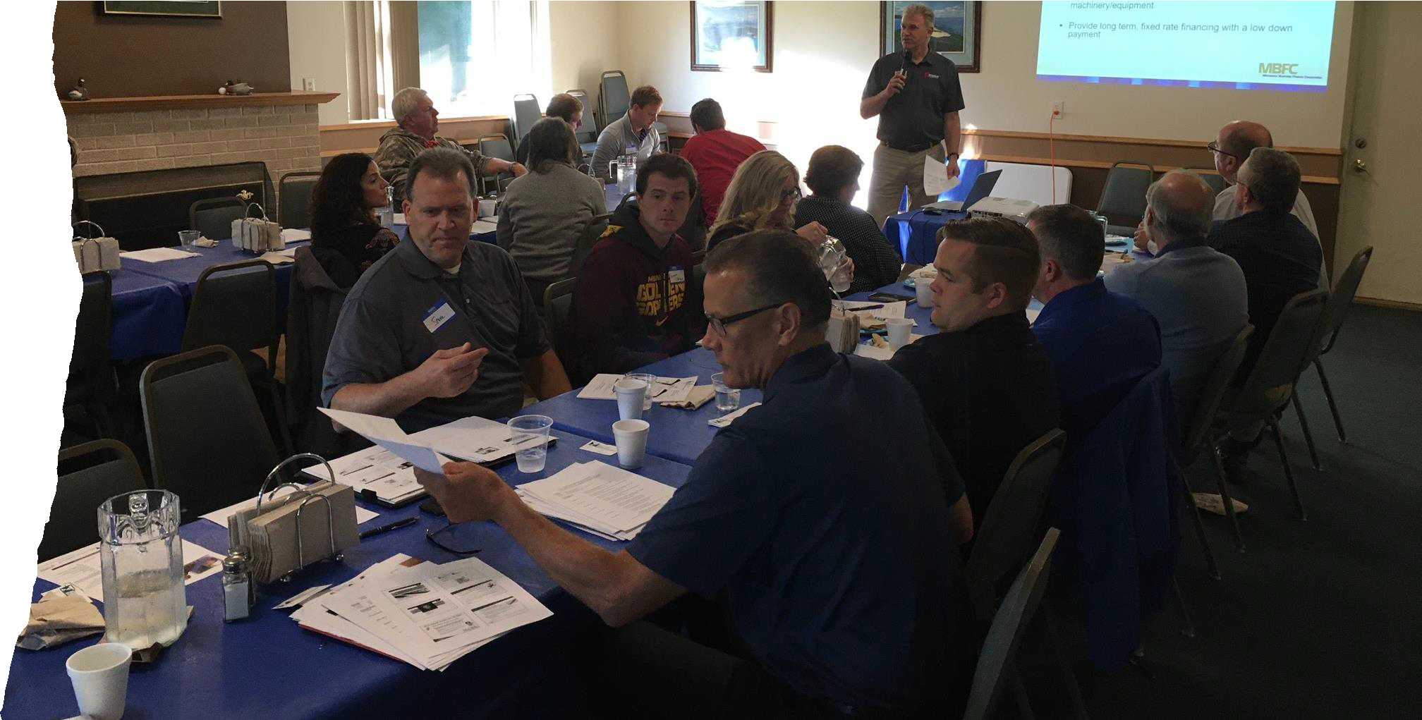
6. Financial Resource Summit
Find a location. Golf helps.
Invitees: lenders, entrepreneurs, business leaders, elected officals, cities, counties, etc.
Speakers:
-Service providers (SBDC,
SCORE, etc.)
Lenders (RDC, Foundation)
Bid Dogs (SBA, DEED, etc.)
Networking afterwards (GOLF)

Slide 9
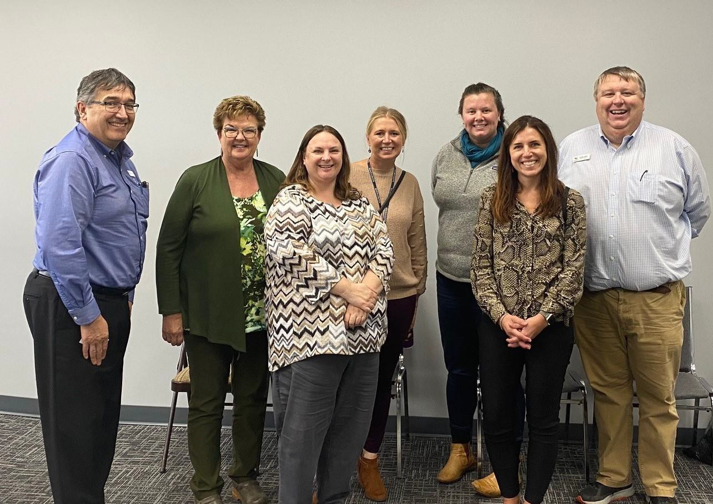
7. Barnstorming
Quick, unannounced visits to banks, credit unions and city halls. Maybe Chambers, too?
Bring friends… SBDC, DEED, County Eds,
Foundations, SBA, Regional Partners.
Hand out business cards, business assistance directories, RLF brochures, etc.
Tell them what you have to offer.
Find out what they have on the burner.
Take a photo, acknowledge on social media.

Slide 10
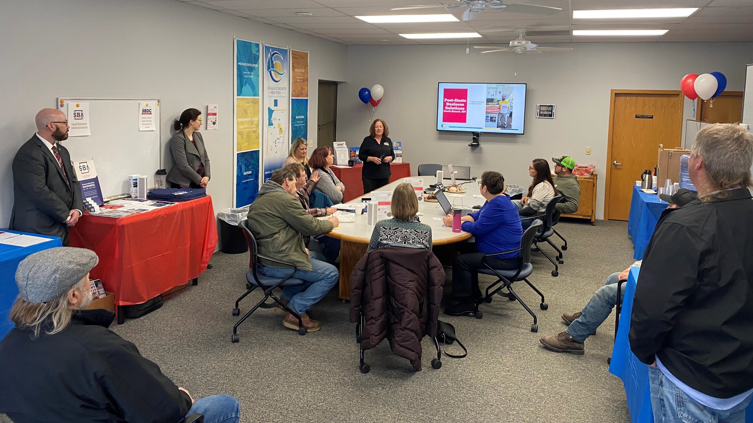
8. Open House / Resource Fair

Slide 11
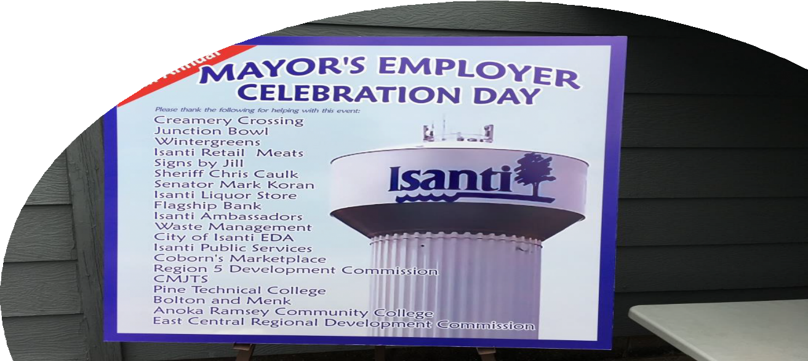
9. Business Appreciation Picnic
Invite local businesses
Picnic lunch
Brief speeches from elected officials / economic developers.
Awards for milestones
Anniversaries that end in 5 or 0
New Businesses

Slide 12
10. Social Media

Slide 13
11. Email Blasts
Cities
Counties
Chambers
Your Board (Commission, RLF, CEDS, etc.)
Lenders
Economic Developers
State / Congressional Elected Folks / Staff
Partners (DEED, Vet Service Reps, SBDC, etc.)

Slide 14
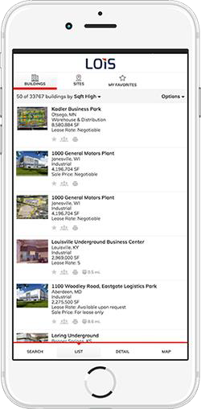
12. LOIS
Location One Information Systems (LOIS).
DEED has free accounts for all MN LUGs.
Contact CARD @ DEED for an account.
List real estate MLS style.
Prints fancy brochures.

Slide 15
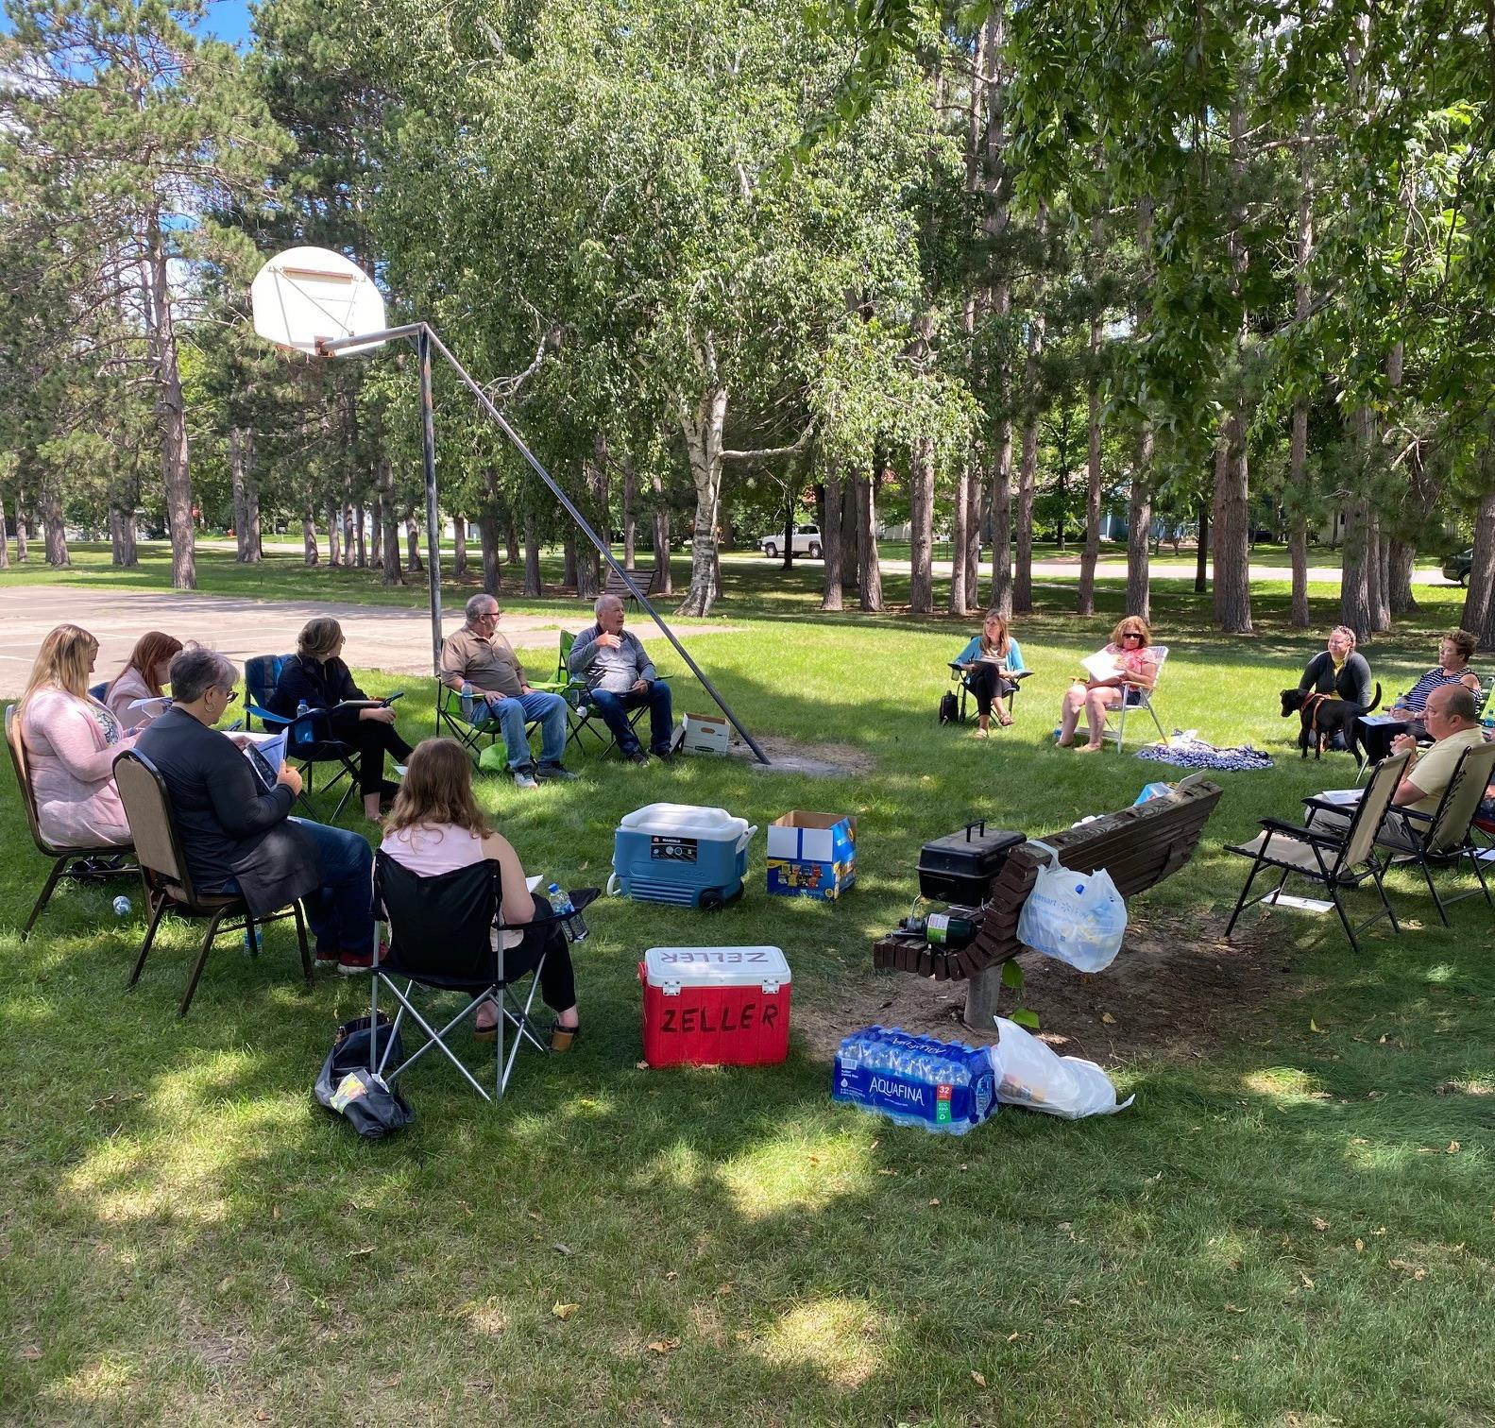
13. City / County Clerks, Administrators, Community / Economic Developers & Partners Meetings
Quarterly???
In person or online.
Lunch
A few speakers on economic
development topics
DEED
EDA
Site Selector
Developer
Housing

Slide 16
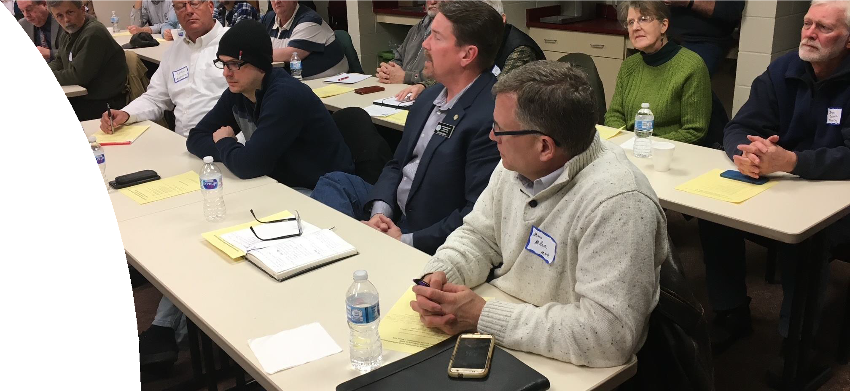
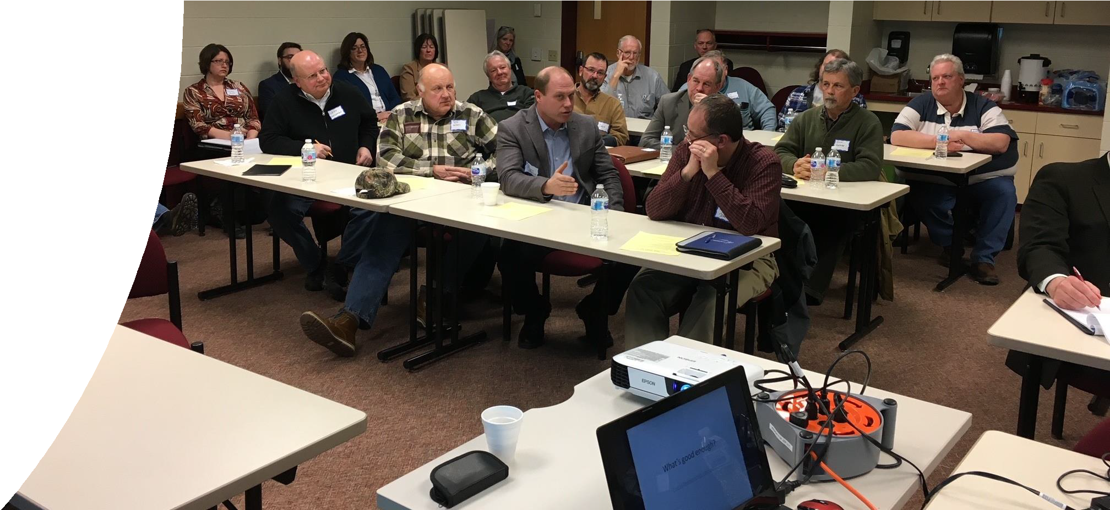
14. Legislative Roundtable on Economic Development
After election, before session
Invitees: State / Congressional Delegation, state department leaders.
Invitees: City / County / Township Officials
Agenda
Welcome
Keep it on topic / civil
A speaker or two to chat on a relevant
topic (Broadband, DEED programs, etc..
Each politician gets two minutes on goals for the
session.
Coffee & cookies.

Slide 17
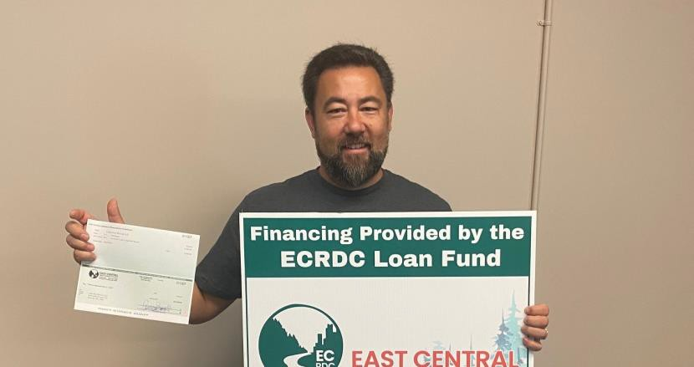
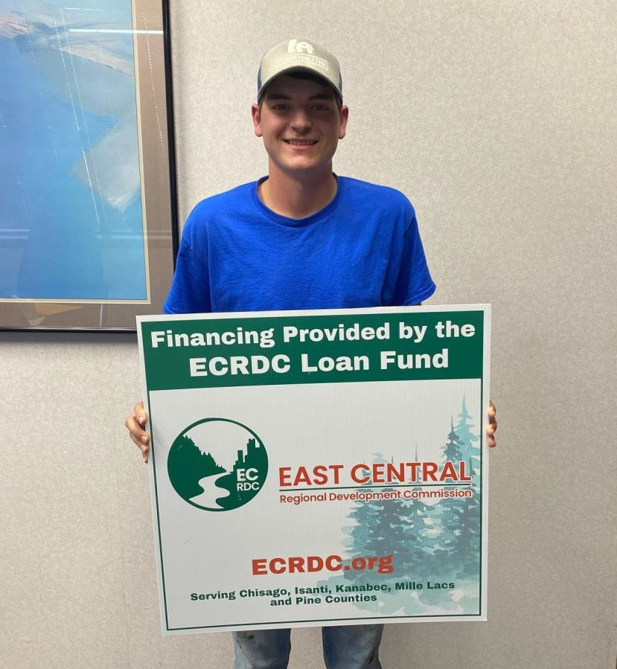
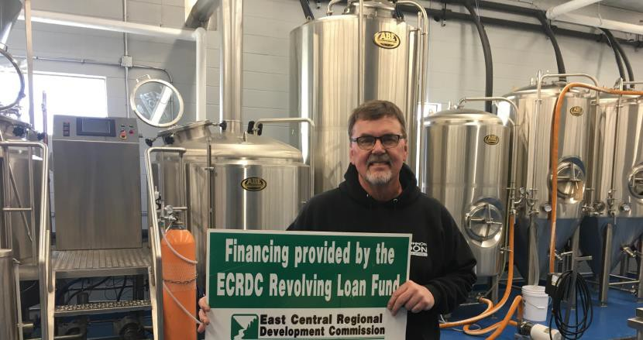
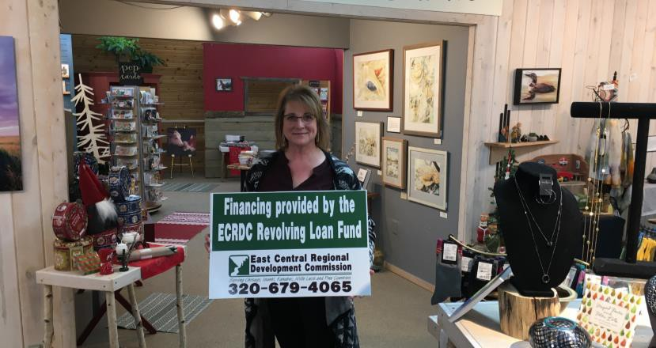
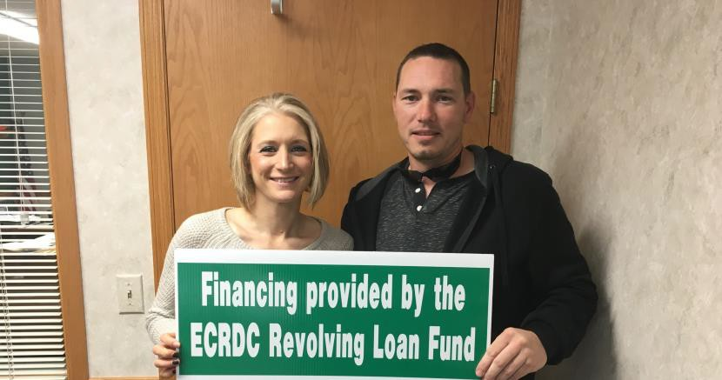
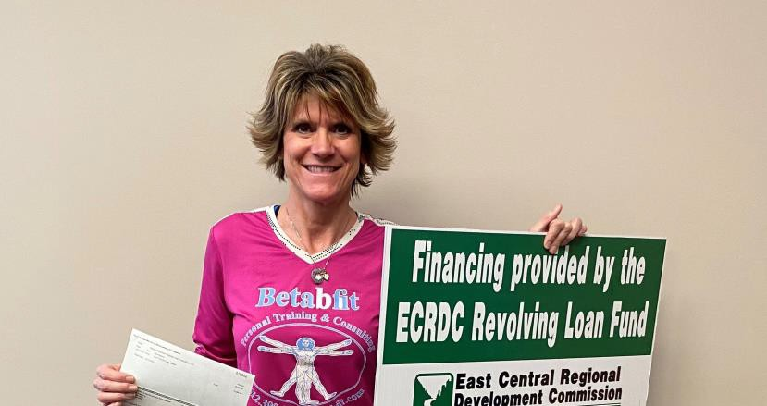
15. Signs

Slide 18
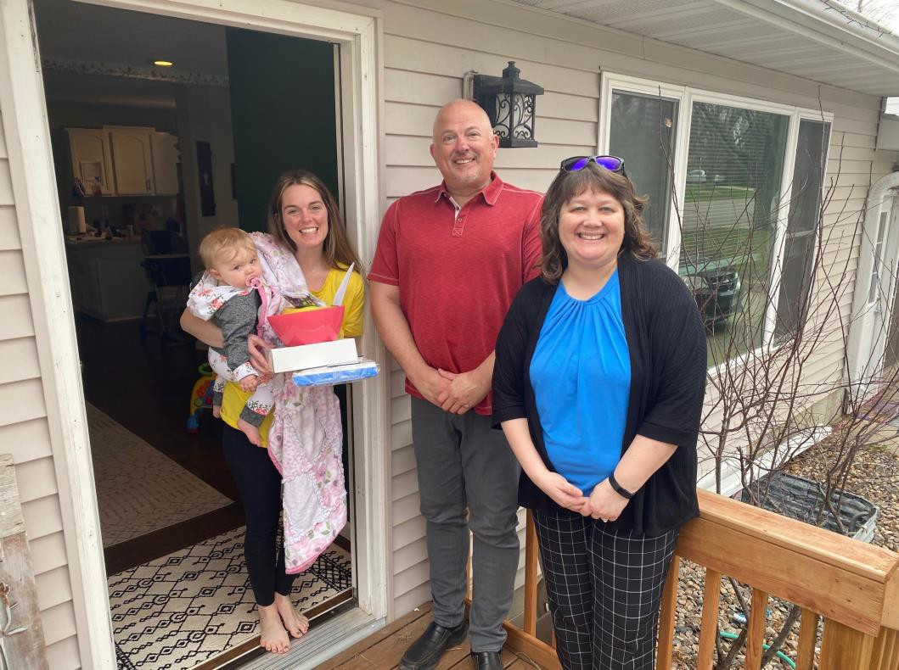
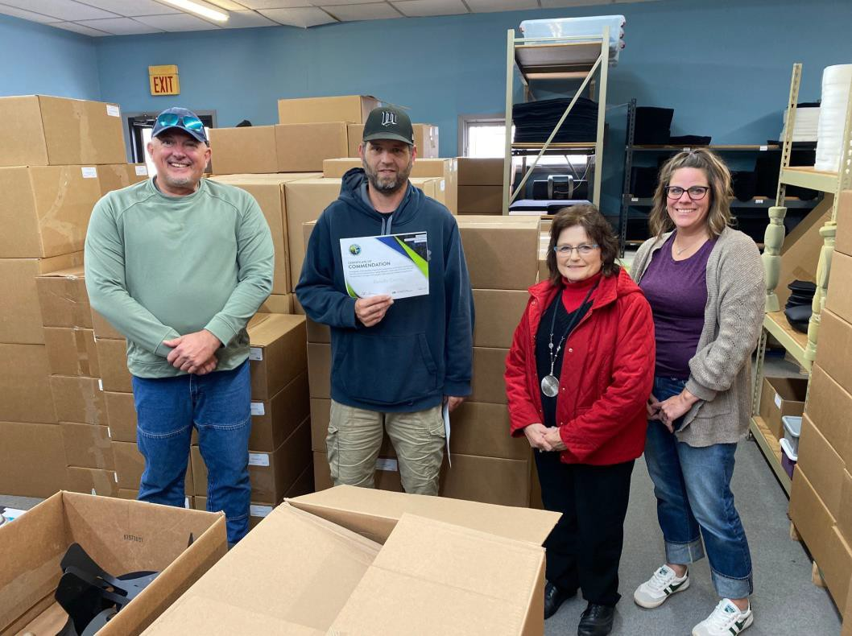
16. Celebrate Your Businesses!

Slide 19
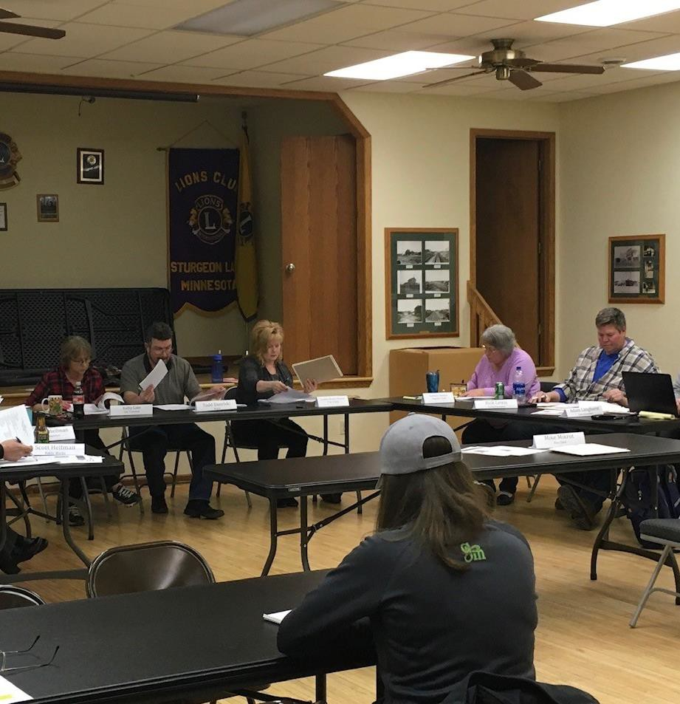
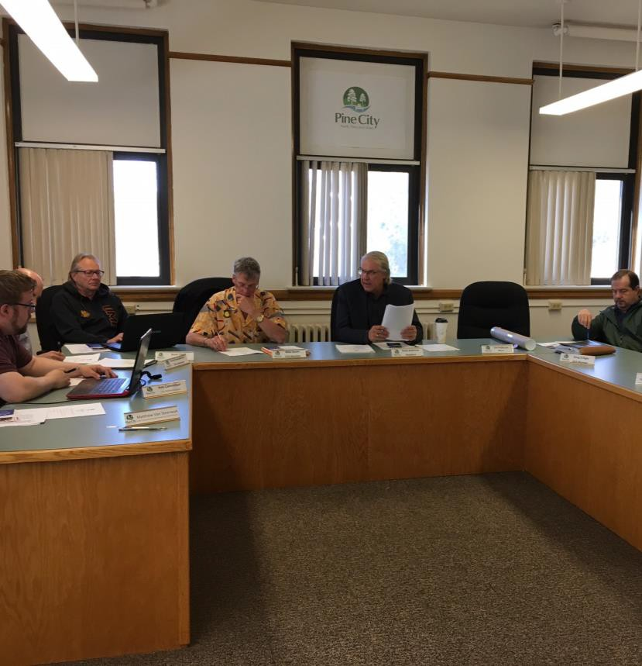
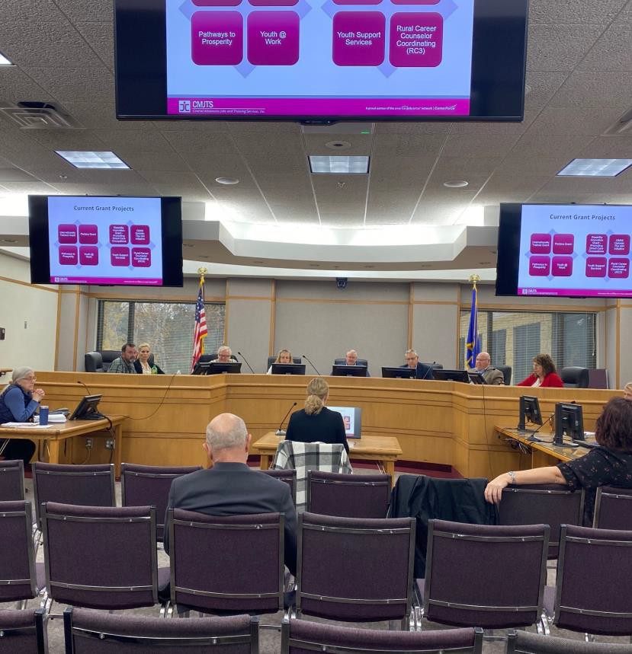
17. Go to local Commissioner / Council / EDA Meetings

Slide 20
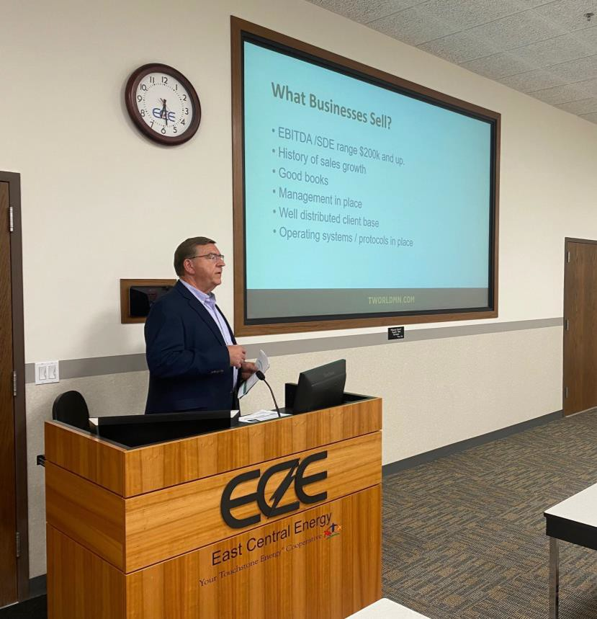
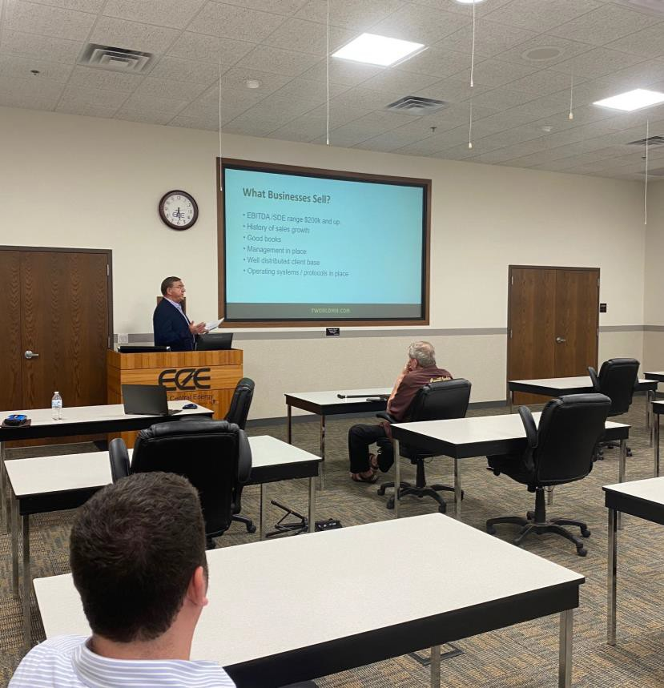
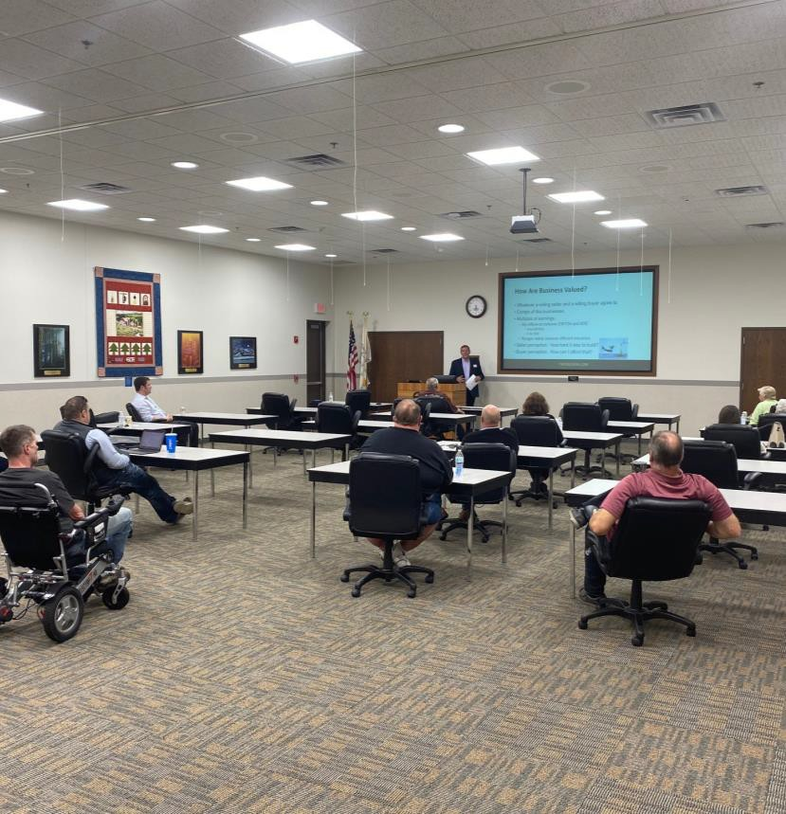
18. Inventors & Entrepreneurs Club

Slide 21
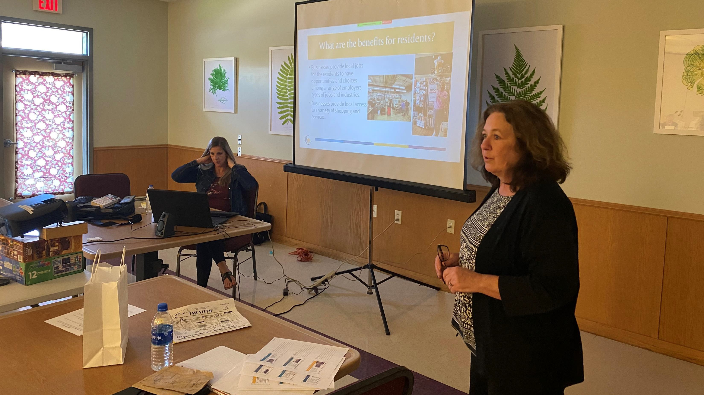
19. Business Retention & Expansion (BR&E)

Slide 22
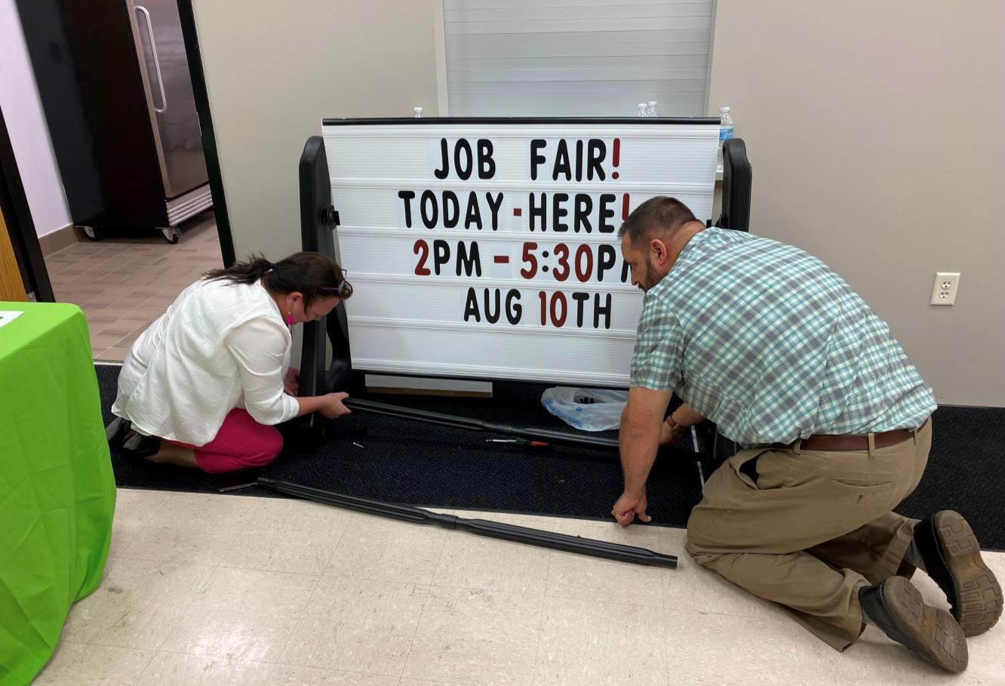
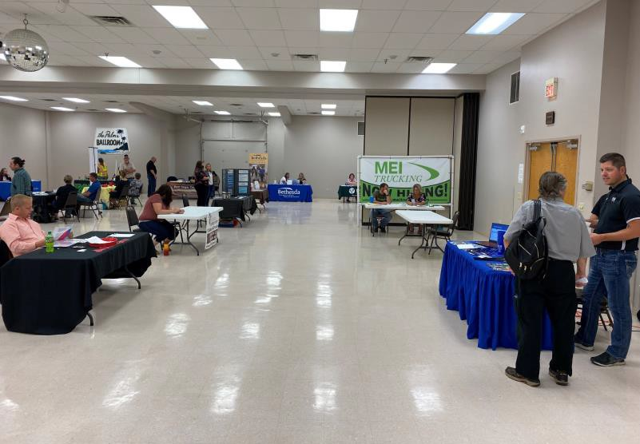
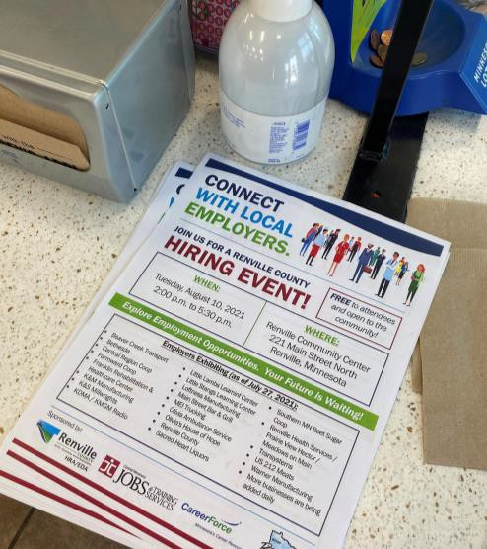
20. Hiring Event

Slide 23
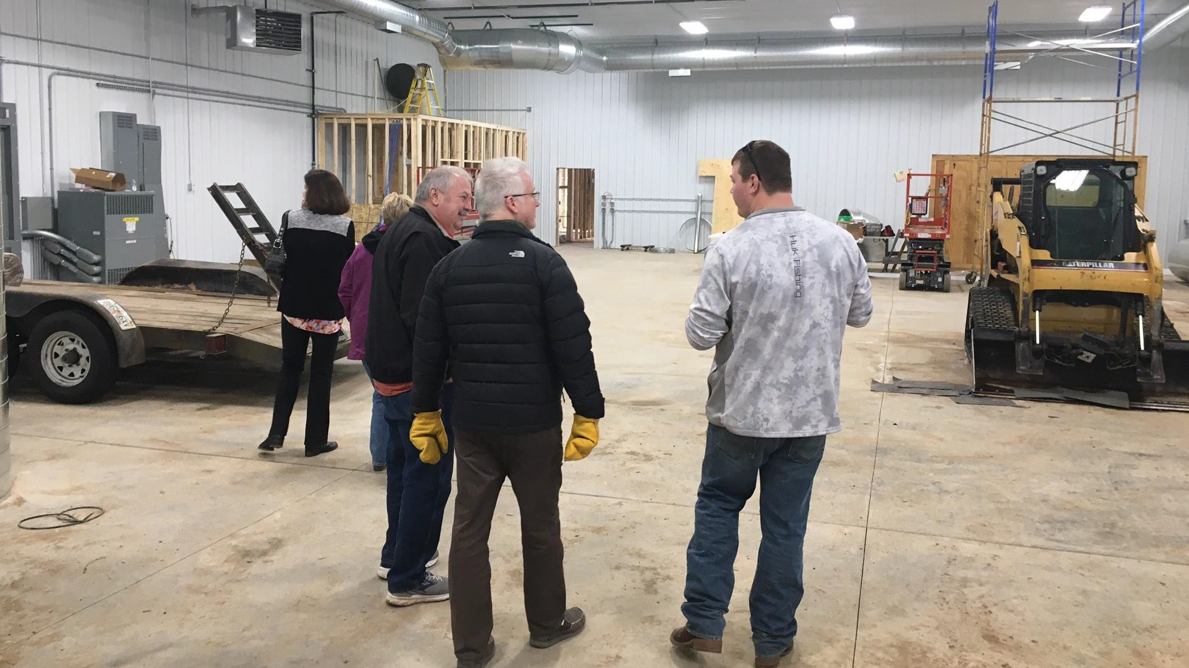
21. Manufacturing Association

