Slide 1
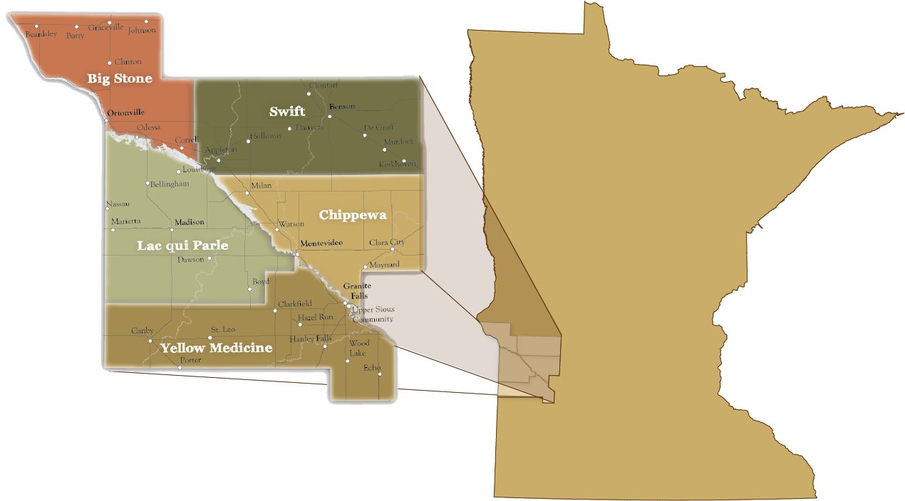
Big Stone || Chippewa || Lac qui Parle || Swift || Yellow Medicine

Slide 2
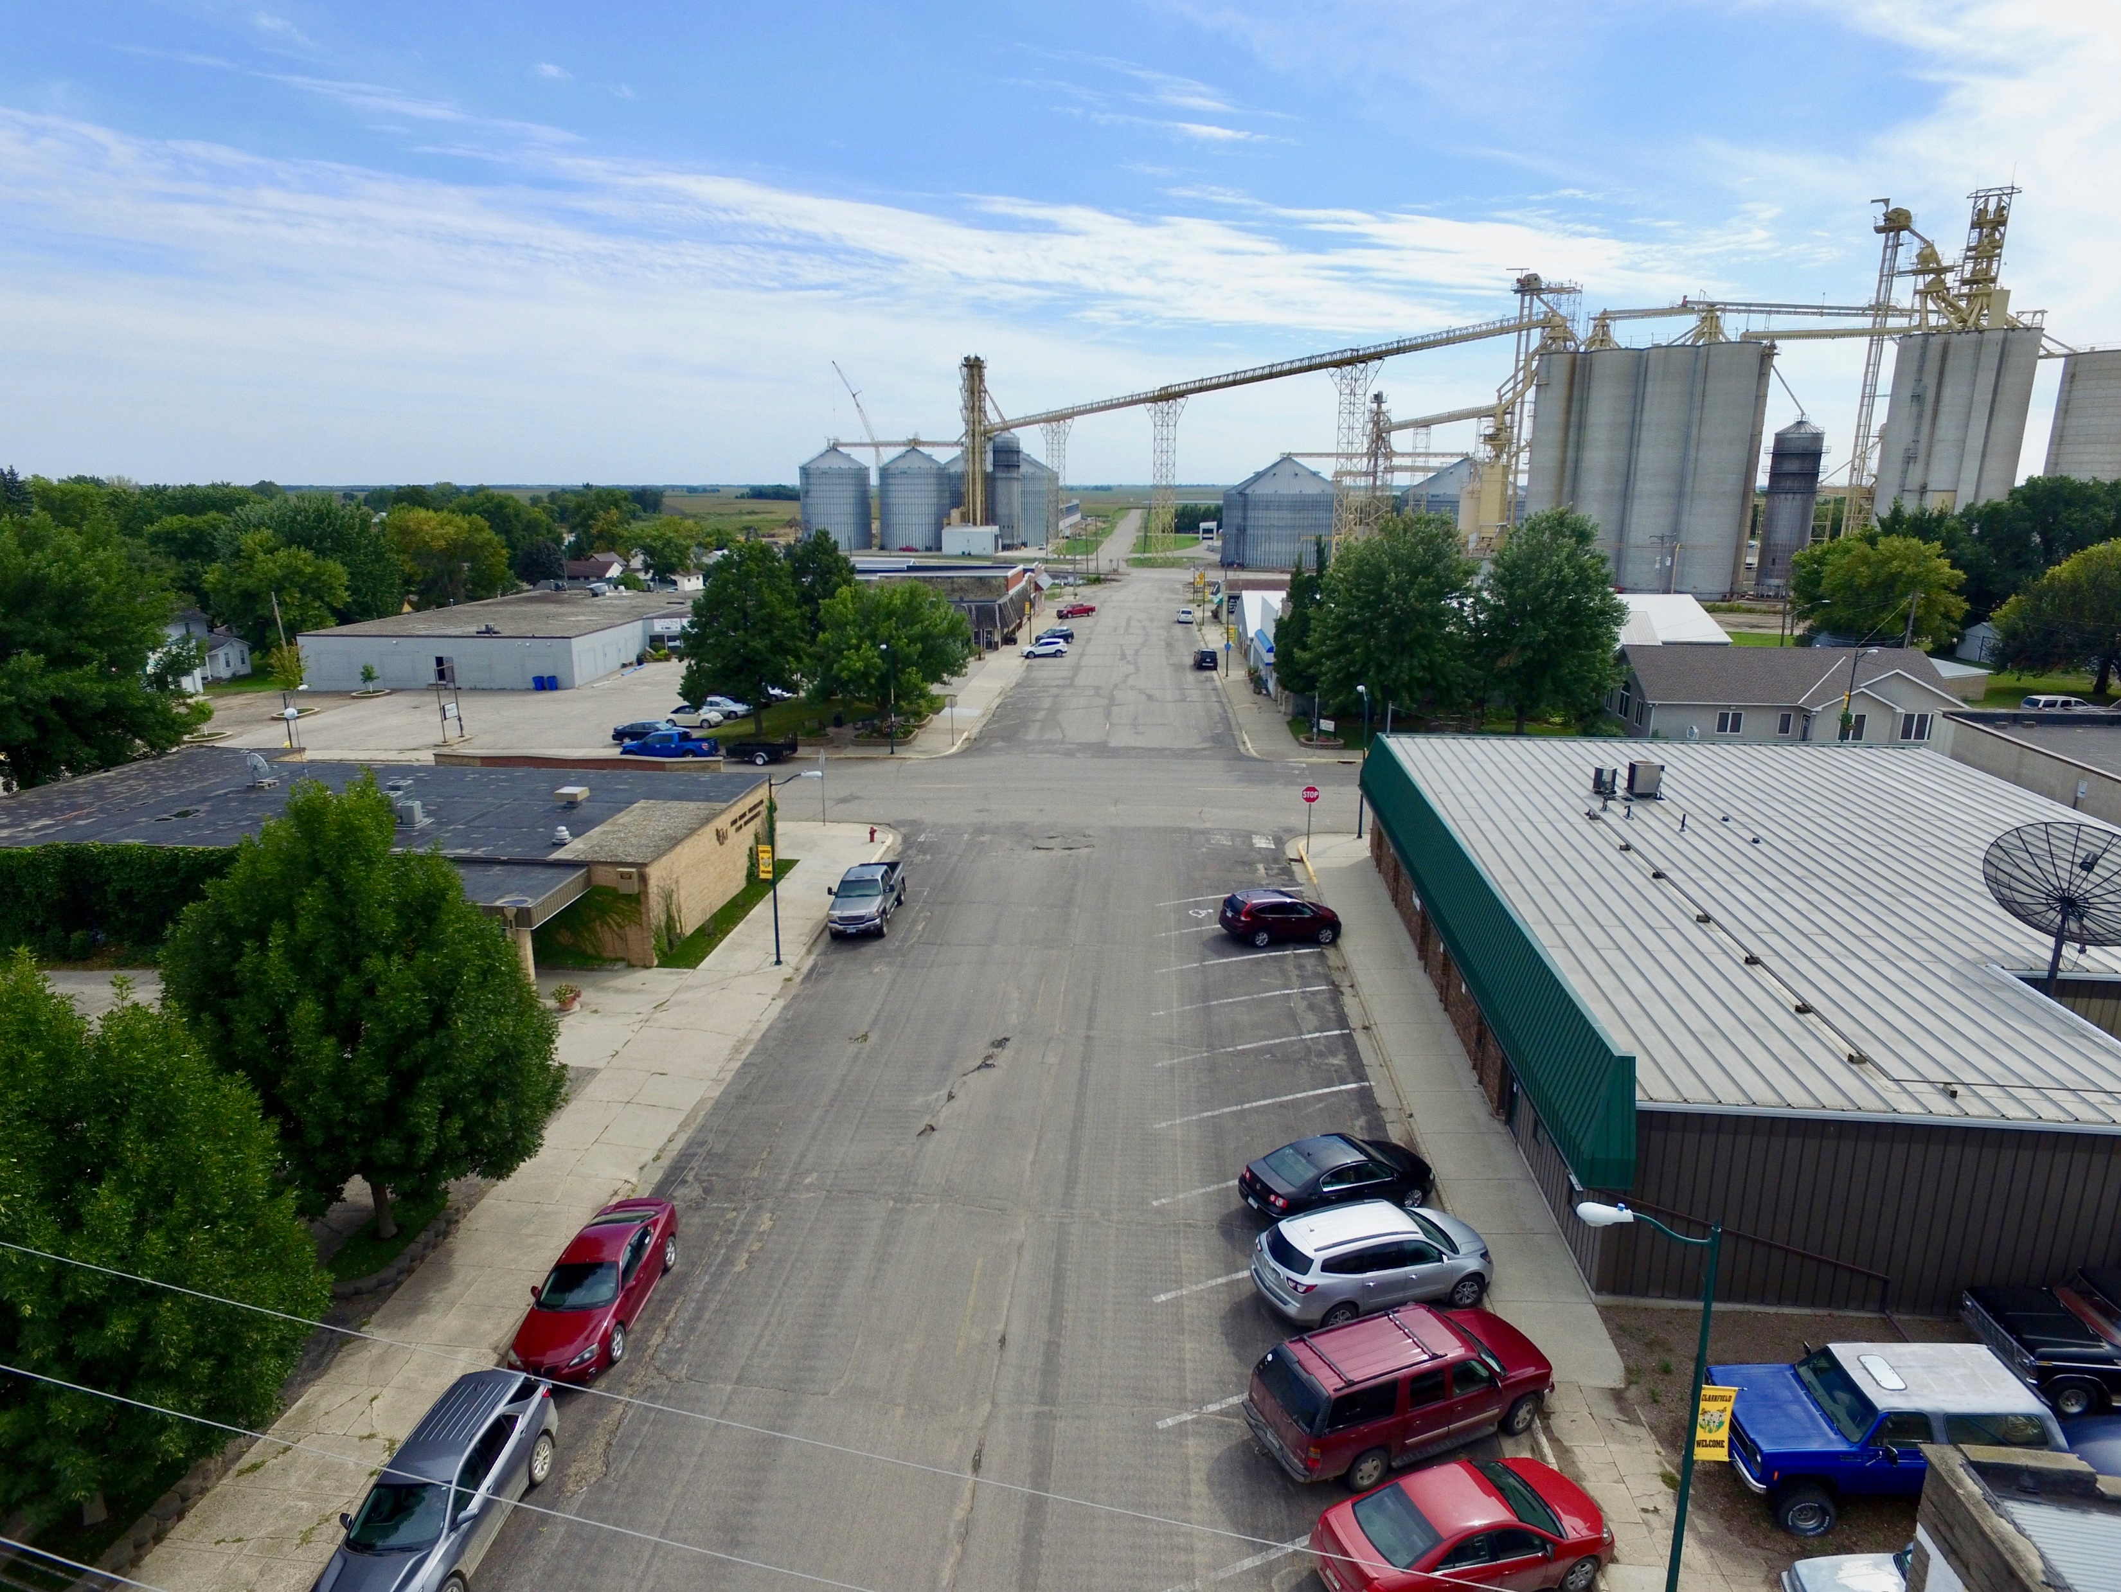
Small Cities Development Program

Slide 3
What is SCDP?
Purpose of SCDP?
Federal funds from U.S. Department of Housing and Urban Development (HUD) – Community Development Block Grant Program (CDBG)
HUD gives CDBG money to MN Dept. of Employment and Economic Development (DEED) who awards these funds annually through a competitive application process called the SCDP.
.
Develop viable, eligible communities by providing financial assistance to address the need for decent safe affordable housing, economic development and public facility needs; AND
Provide a suitable living environment by expanding economic opportunities, principally benefiting low to moderate income households.

Slide 4
Minimum Requirements
Project must meet one of the three federal objectives
Benefit to low-and-moderate income persons
Elimination of slum and blight conditions
Urgent Community Development Need
Maximum Funds Awarded
$600,000 for a single activity such as public facilities or housing rehabilitation
$1.4 million for comprehensive projects
Funds are most commonly applied for improvements to:
Owner Occupied Rehabilitation (residential)
Commercial Rehabilitation (business)
Rental Rehabilitation (multi-unit or single-family rental units)
Public Infrastructure

Slide 5
Grant Timeline
Pre-applications are due in the fall (November)
If invited, a full application is due in winter (February)
Grants are awarded in Spring (June/July)
Project implementation and administration processes and environmental reviews take place from July-September
SCDP grant money could be available for use around September-October
Money needs to be spent down within three years following contract awards

Slide 6
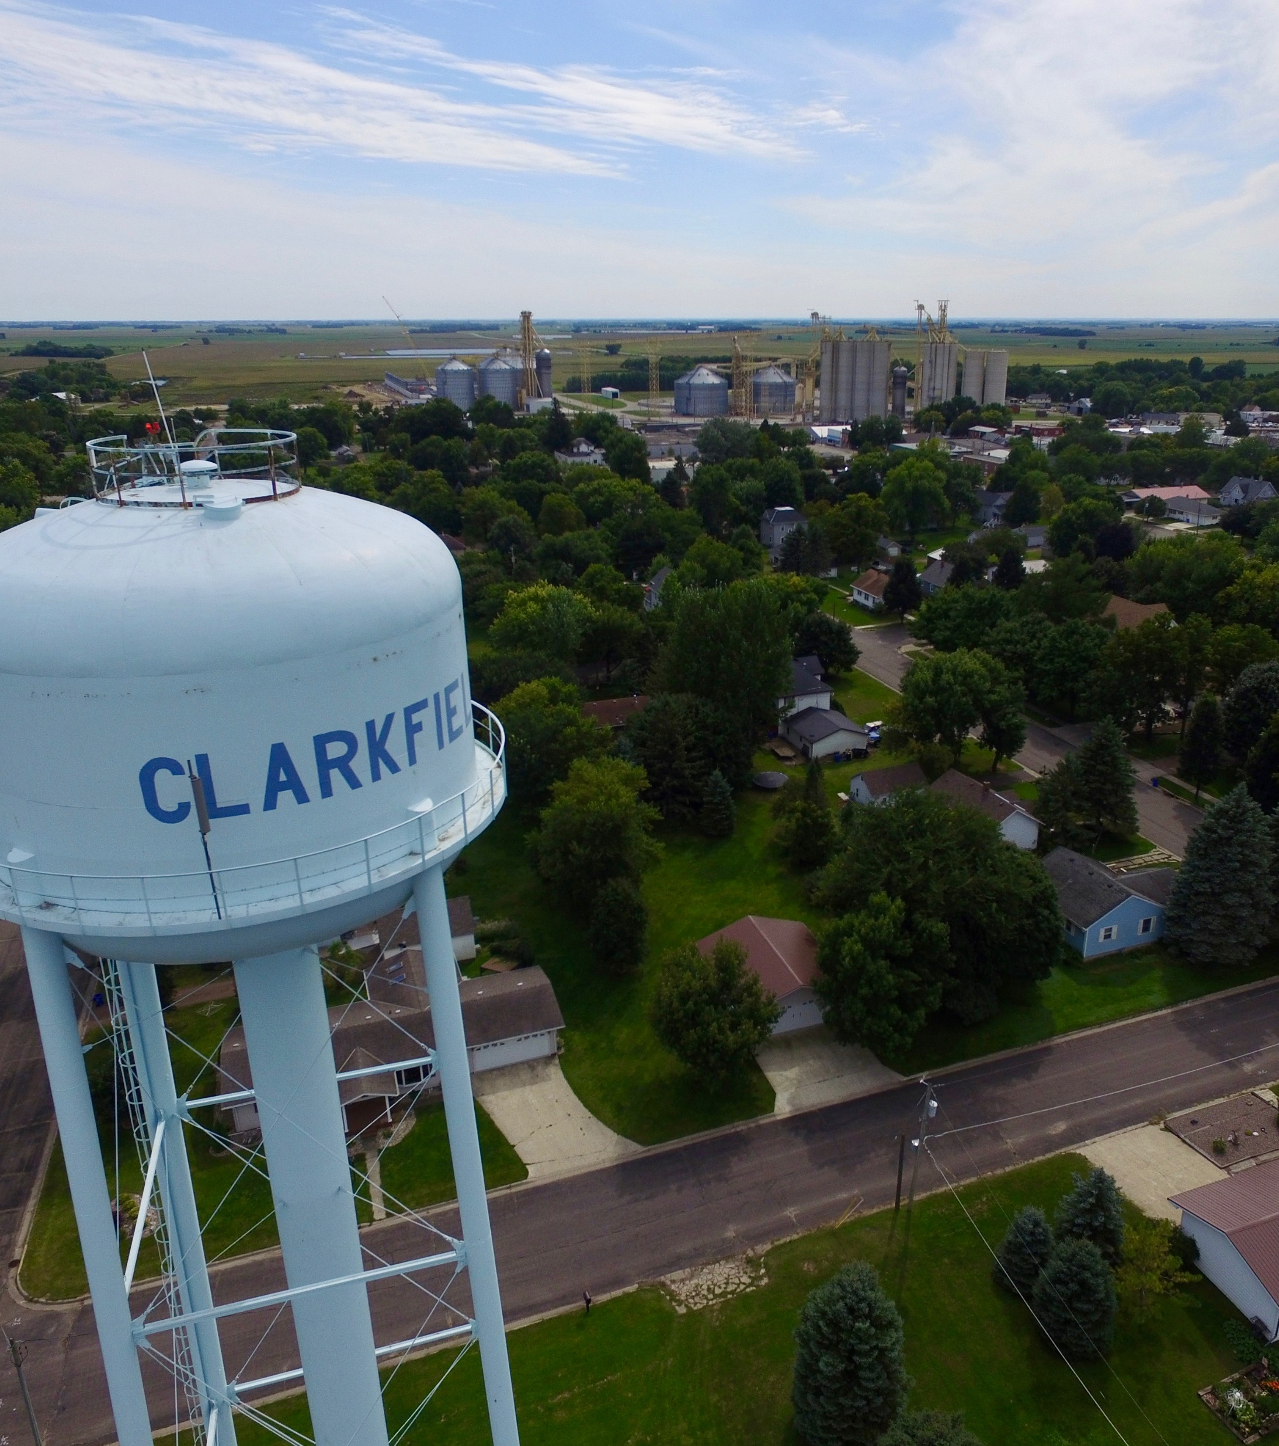
EXAMPLE: Clarkfield, MN
32+ years of deferred maintenance on city’s water tower
Reoccurring freezing, required residents to run water during winter months to avoid
17,000 gallons of water consumed/per day
Homes/businesses reported continuous sewer back-ups
Needs
Updated water tower, wastewater treatment system, and storm sewer

Slide 7
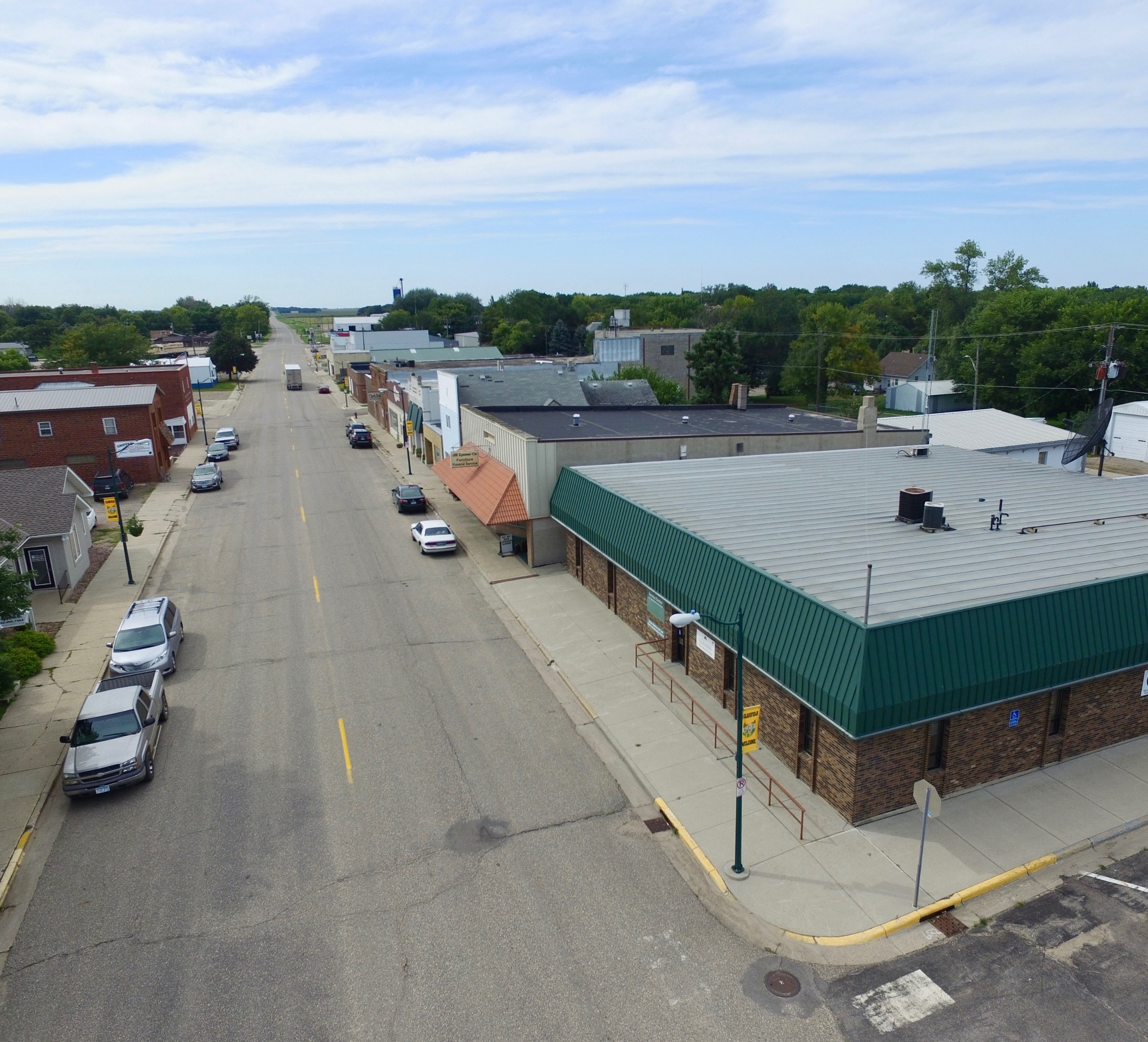
Collaboration
City, city’s engineer, and UMVRDC
City’s engineer
Engineering report, secured funding sources Minnesota Public Facilities Authority and Rural Development
UMVRDC
City-wide income survey work, housing/commercial rehab interest survey, secured SCDP funding

Slide 8
Project management
Engineers
Wastewater treatment system and storm sewer
UMVRDC
Housing and commercial rehab projects
Collaboration
Water tower
A
B

Slide 9
Project Funding Sources
Activity | # of units/goals | SCDP Cost Per unit | SCDP Cost/ without admin | Total SCDP Admin | SCDP Admin % | Total SCDP Costs | Total Leveraged Resources | Source of Leveraged Funds | Totals
Owner Rehab | 15 | 18,750 | 281,250 |  |  | 281,250 | 170,750 | Owner, Weatherization, Energy Related Repair Program, MNHFA | 452,000
Owner Rehab Admin | 15 | 2,812 |  | 42,180 | 15.0% | 42,180 | 11,607 | City | 53,787
Commercial Rehab | 5 | 32,000 | 160,000 |  |  | 160,000 | 35,000 | Owner | 195,000
Commercial Admin | 5 | 4,800 |  | 24,000 | 15.0% | 24,000 | 3,868 | City | 27,868
Public Infrastructure | 1 | 580,000 | 580,000 |  |  | 580,000 | 21,950,500 | PFA/RD City | 22,530,500
Public Infrastructure Admin | 1 | 20,000 |  | 20,000 | 3.4% | 20,000 | 873,300 | PFA/RD City | 893,300
 |  | Totals | 1,021,250 | 86,180 |  | 1,107,430 | 23,045,025 |  | 24,152,455

Slide 10
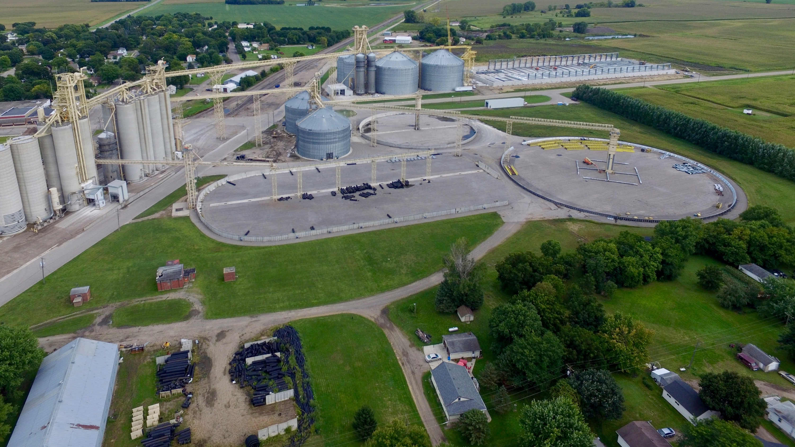
QUESTIONS?

