Slide 1
Child Care Panel 2019 MADO All Staff Retreat
MMDC’s Information on Kandiyohi County’s Child Care Planning Efforts

Slide 2
Kandiyohi County utilized First Children’s Finance’s RURAL CHILD CARE INNOVATION PROGRAM (RCCIP)
My presentation will discuss this planning process, the developed strategic plan, and some early successes.
Notes:
First Children’s Finance is a non-profit organization started in the Twin Cities to help child care entrepreneurs start and grow sustainable businesses by providing access to capital, business training and consulting. FCF’s Role in the RCCIP process is being the: Facilitator, Educator, Supporter.
Need to apply to First Children’s Finance to undertake the program funded by funded by MN Department of Human Services. They can only do several per year.
Few minutes explanation that took 6 hours at first Core Meeting event.

Slide 3
The RCCIP is a community engagement process designed to develop right-sized solutions to address the needs of early care and education in a rural setting.
The goal of the program is to help communities identify the scope and size of their childcare challenges, and to empower and support communities to develop solutions to address these challenges.
Notes:
MMDC is part of the CORE Team working on this for Kandiyohi County that is toward the end of their process. Meeker County has successfully applied and will just beginning the process, MMDC will also be on their Core team. I will be focusing on the experience with Kandiyohi County.

Slide 4
Kandiyohi County’s CORE TEAM MEMBERS:
Several staff from United Community Action Partnership (Local Lead)
Kandiyohi Co. Public Health
Kandiyohi Co. Child Care Licensing
Business – Jennie-O Turkey Store
Child Care Providers & Head Start
Willmar Area Community Foundation
Early Childhood, Willmar Public Schools, and another school staff member
Bethesda Adult Living Centers
County Commissioner
MMDC & Southwest Initiative Foundation
County/Willmar Economic Development
Ridgewater College

Slide 5
Currently Kandiyohi County has Childcare Centers with a maximum capacity of 1,289 slots, and 91 Family Childcare businesses with 978 maximum capacity slots.
In addition, other excluded care offerings include Head Start /Preschool/ Part-time Care (7 programs with 238 slots)

Slide 6
FCF’s Zip Code Analysis shows a need for an additional 776 childcare slots in Kandiyohi County.
How is this need supported today?
Legal Unlicensed Care /Family, Friends, Neighbors
Unemployment
Under-employment/shift realignment
Illegal unlicensed care
Out of area care
Notes:
Their analysis digs much deeper into types of slots, location, affordability, etc.

Slide 7
The RCCIP Process:
Pre-Work: *Data gathering, *Promotion
Town Hall: *Showcase findings, *Community input, *Identify potential community solutions
Action Plan: *Projects identified that will build and sustain supply
Call to Action: *Execute projects, *Identify resources, *Solidify partnerships
Learning Communities: *Web based, Connect with other communities
Local Resources
Right Sized Solutions
+ Innovation
SUSTAINABLE SUPPLY

Slide 8
Community Engagement
Target audiences:
School Board/School System
Political Leaders
Faith Community
Lenders/Financial Institutions/Econ. Dev. Professionals
Business Community
General Community
Parents
Other
Find Bob – the mover & shaker

Slide 9
Community Engagement Call to Action
One-one Interviews
Focus groups
Surveys
Presentations
Provider Appreciation Event (includes input)
Town Hall Recruitment and Meeting
From all the information collected the Core Team Prepares an Action Plan.
Action Plan utilizes SMART Goals, action steps, and reporting on progress.

Slide 10
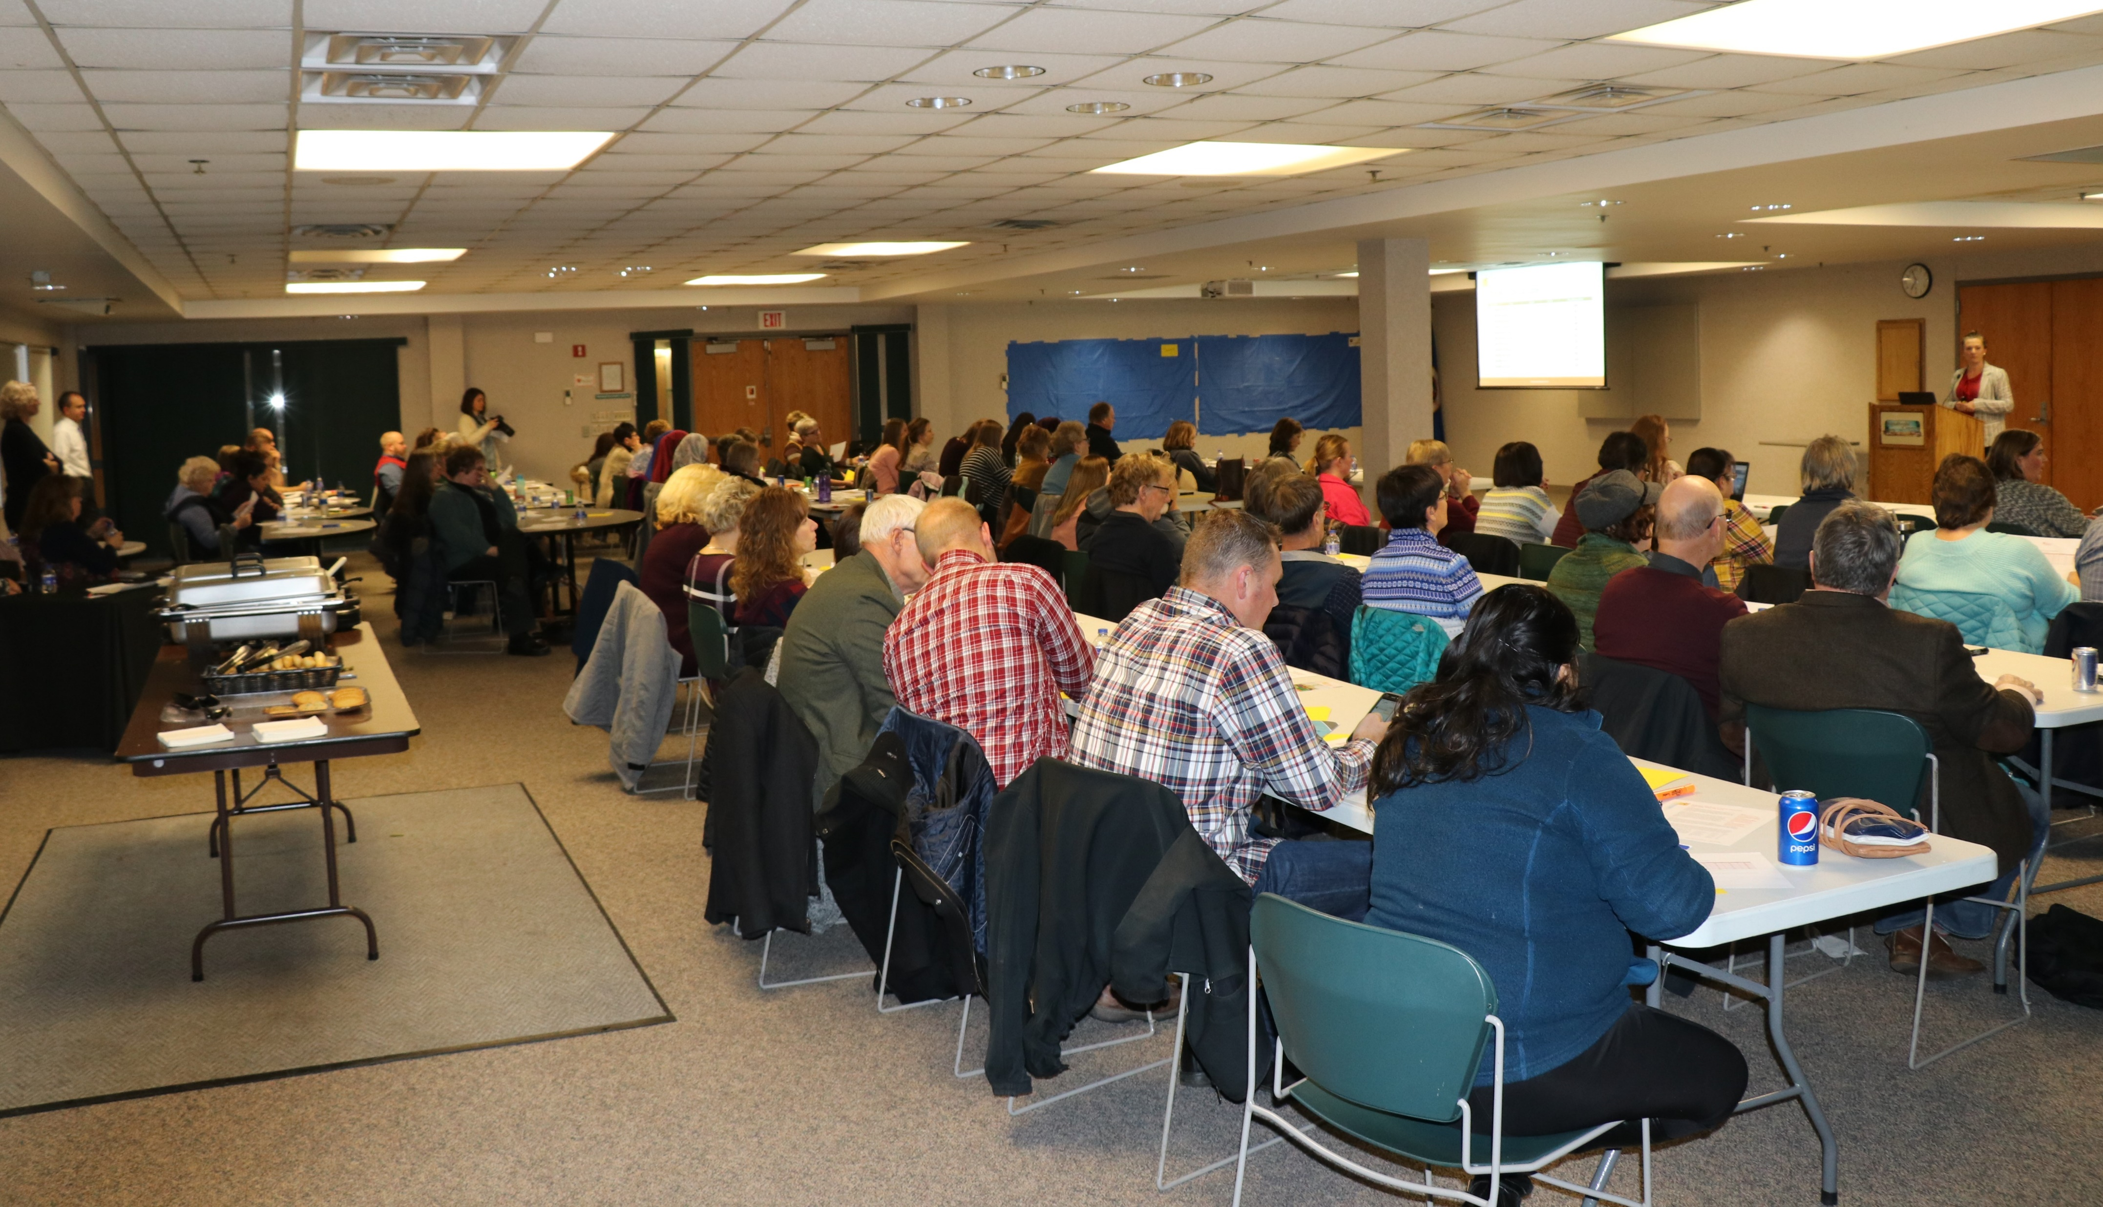
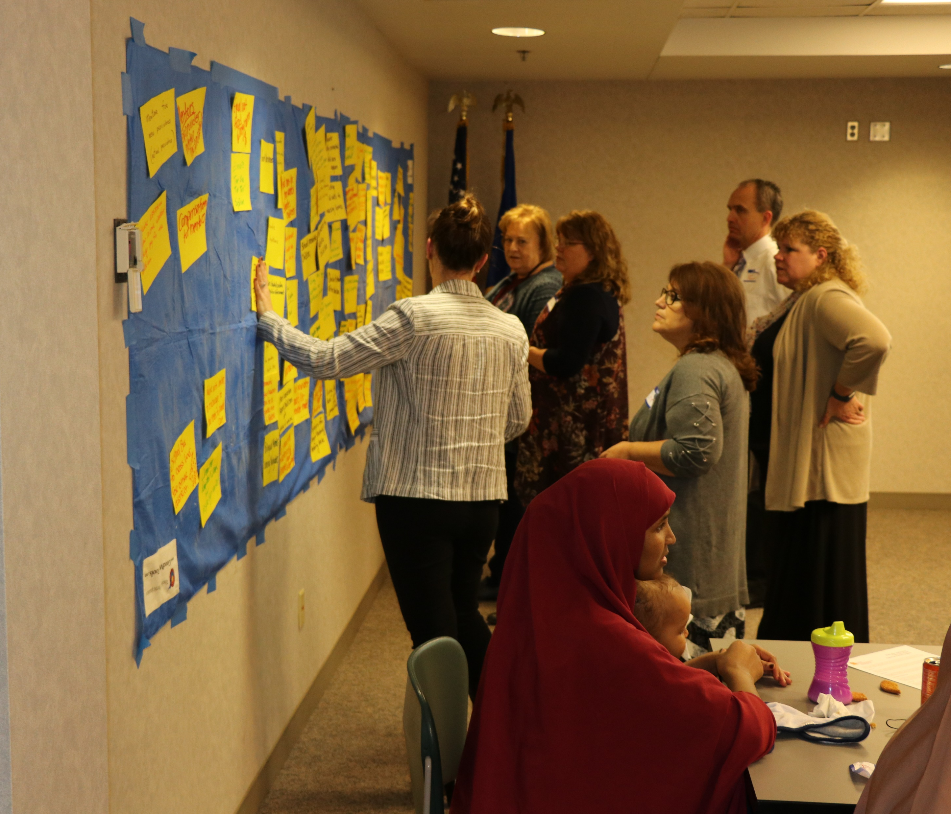
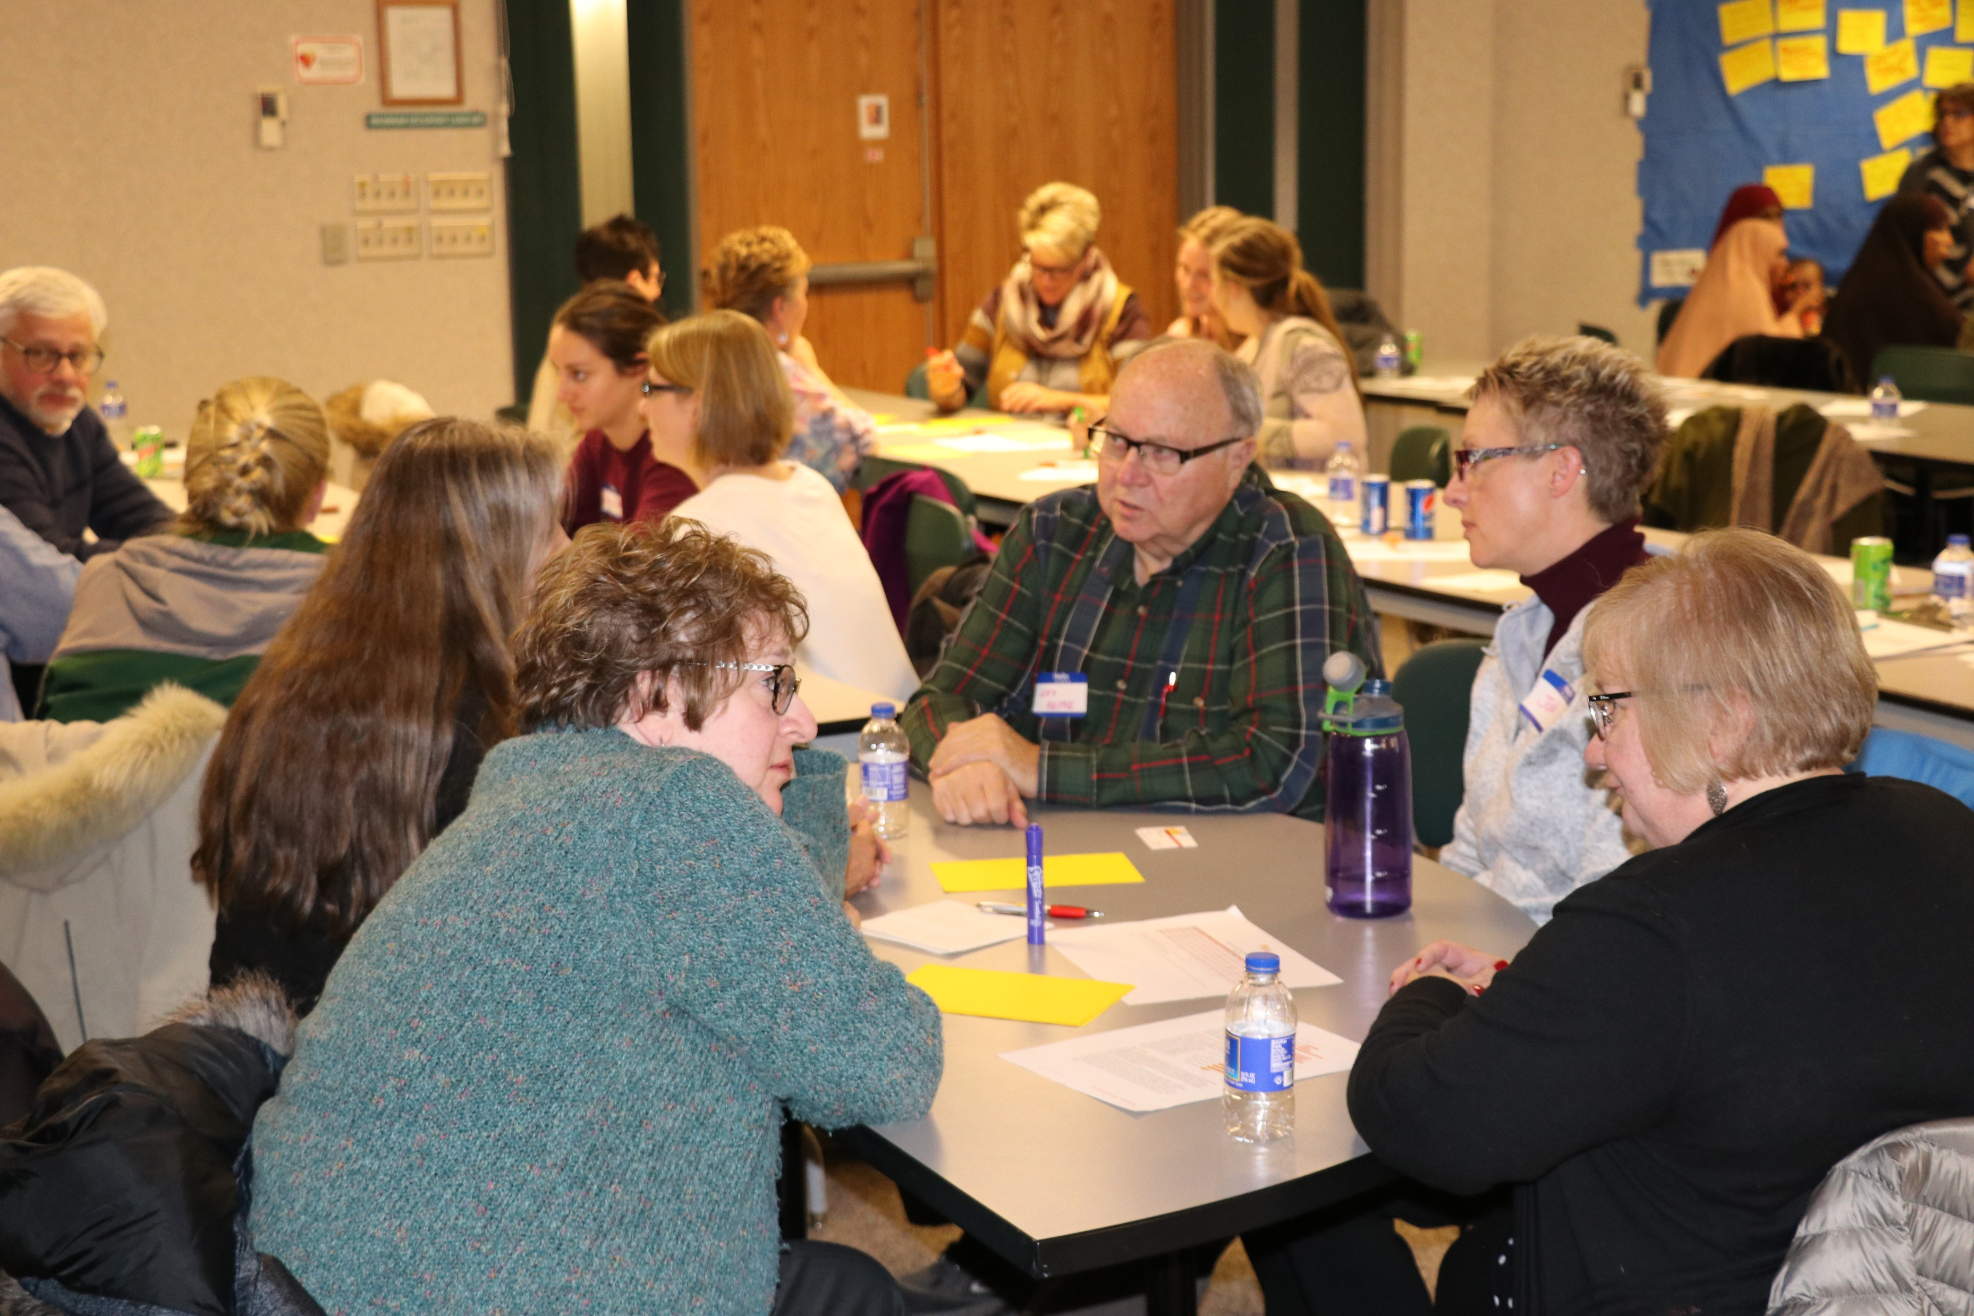
Pictures from Town Hall Meeting

Slide 11
Kandiyohi County Core Team’s Work Plan
Team 1
Streamline professional development opportunities within the county.
Increase networking opportunities for early childhood professionals.

Slide 12
Kandiyohi County Core Team’s Work Plan
Team 2
Increase awareness of business planning and funding opportunities for new and existing child care programs.
Increase financial supports for child care programs within Kandiyohi County.
Identify non-owner occupied space for potential child care programs.

Slide 13
Kandiyohi County Core Team’s Work Plan
Team 3
Develop a Scholarship Program to support individuals pursuing child care education.
Provide three Provider Appreciation Activities in Kandiyohi County over the next 24 months.
Develop a system to support English language learners/diverse persons working or desiring to work in the child care field.

Slide 14
Early Successes
Two new Child care centers being constructed and will open soon.
YMCA’s center at the Green Lake Mall in Spicer - 60 slots
Childcare Center being built in a current building in Willmar’s Industrial Park. Owned by a Somali Business and being financed by loans from MMDC, County EDC, SWIF, African Development Center and a local bank – 60 slots and expandable.
Notes:
Spicer and New London fund raising to assist Spicer project. Local assistance being provided to Somali Business help get the business organized to start up.

Slide 15
Early Successes
I prepared a document called “Kandiyohi County Guidance on Financial Assistance for Child Care Businesses”
Team visited with local bankers on supporting future childcare business loans.
The EDC did inventory of possible site locations for potential child care programs.

Slide 16
Early Successes
Ridgewater College has courses that directly tie-in to the childcare industry. This includes a new early childhood exploration class.
Ridgewater College is raising funds for scholarships for people taking classes on childcare. Scholarships offered Spring 2020 Semester.
Professional development and provider networking opportunities have occurred and have been well attended. More are planned.
Notes:
Work on the other identified goals and action steps are also progressing.

