Slide 1
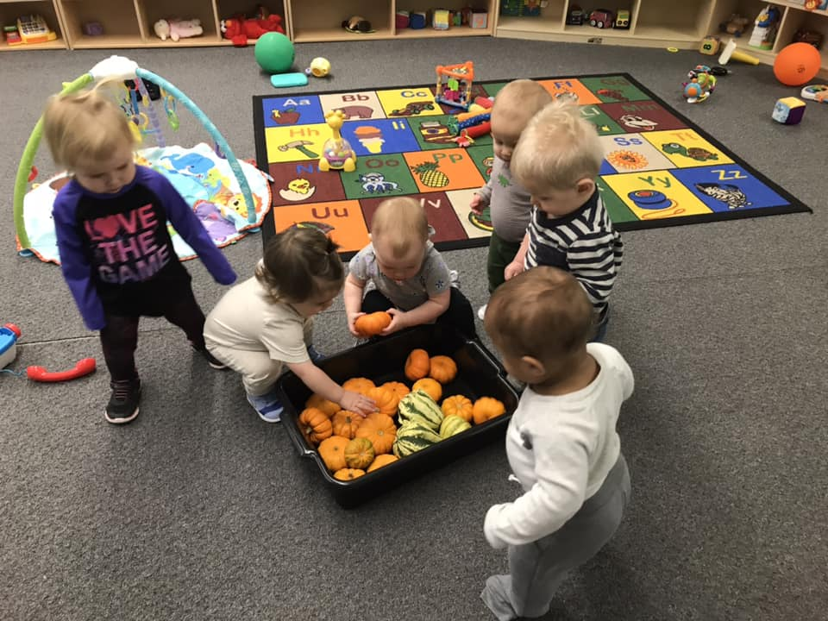
Child Care Case Studies
Jordan Hulscher, UMVRDC

Slide 2
Regional Child Care Case Studies
Connections
Info Gathering
Funding from SWIF for Case Studies

Slide 3
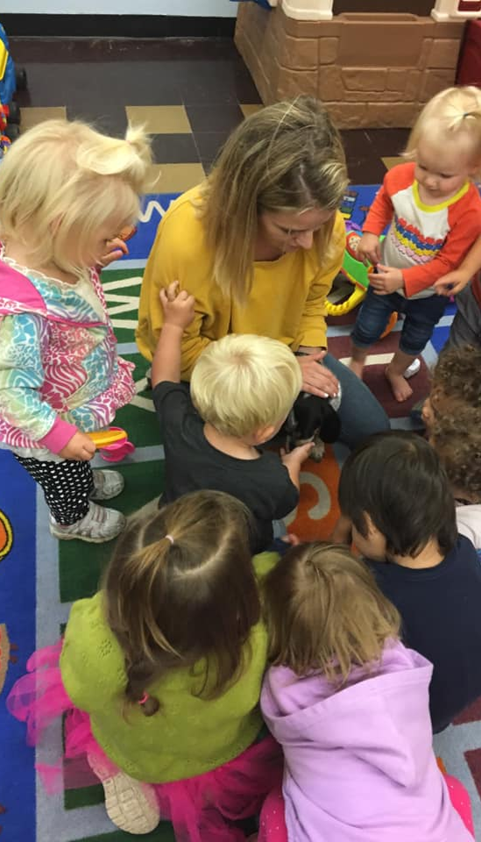
Discovery Kids Benson, MN
September 2017
Child Care Established
April 2018
First Case Study Created
September 2019
Second Case Study Created

Slide 4
Background & Basic Info
1994
Summer/before and after school
Preschool
Infant and toddler care
Building
Schedule
Food
2015
2017

Slide 5
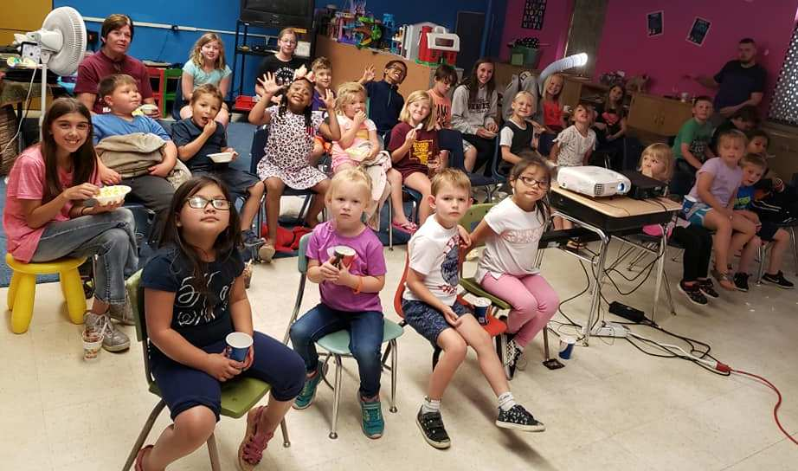
Enrollment & Fees
Enrollment
Licensing
Currently Enrolled
Fees
Contracts
Before and After School
Drop-ins

Slide 6
Staff
Who employs staff?
Breakdown of staff positions and pay
What the child care center does to attract and retain employees

Slide 7
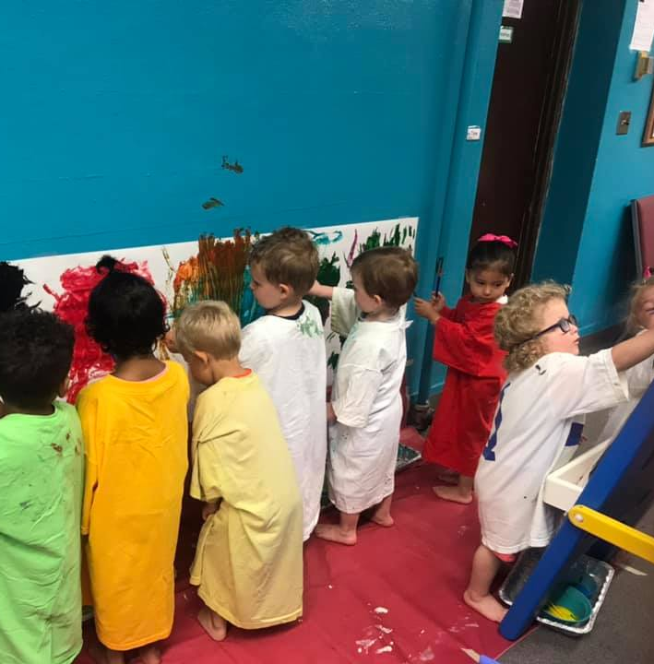
Financing
Start Up Costs
Current Operating Budget
Loans & Grants
Other Sources
Fundraisers
Donations

Slide 8
Challenges and Successes
Challenges
Successes

Slide 9
Contact Info
Jordan Hulscher
Upper Minnesota Valley Regional Development Commission
Email: jordan@umvrdc.org
Phone: 320.289.1981 x 104

